Slide 1

Integrated Solution Baseline Document (iSBD)
for Solution Release Review
Client Name: Andel Energi A/S
Opportunity No: 0063h00000JESMiAAP, DCA: 32009849
Opportunity Name: AMI - Advanced Metering Infrastructure Program
GEO /Market: NCEE (Denmark) /EMEA
Partner Name: Joep van Leersum and Jesper Braum Nielsen
Delivery Leader / Partner: Thomas Due and Joerg Klose
Opportunity Owner Name: Thomas Due
Senior Solution Consultant Name: Andra Hodorogea
Notes:
Owner : SSC These same eight fields are on the Deal Profile Summary Sheet
Pitched by Deal Board – One Min
If SWB is not released, the Geo Leader can stop the SRR
THE PURPOSE OF THE SRR – Executive summary of what was solutioned, what risks the deal has and what help is needed before PRR and/or contract award
In theory, the Lead Service Line has reviewed the entire deal for deliverability.
Top right corner of each slide articulates who pitches the slide and time allocated to it
CONFIRM SWB IS SITTING AT STATUS 60 – Ready for formal Review by Solutioning and Delivery
SWB Status can be found in DCA tool on Deal Information Tab; View Solution Data box

Slide 2
Deal Profile Summary
Profile
Client Name | Andel Energi A/S
Elite / Premier Account?
GEO / Market / Industry | NCEE /EMEA / Energy
Opportunity Name | AMI - Advanced Metering Infrastructure Program
Opportunity Type | New
Opportunity Number | 0063h00000JESMi
Sales Stage | Propose
Solution WorkBench (SWB) Stage | 40 - Solution Build
Term | 96
Credit Rating
Complex Opportunity? | Y
Financial and Contractual Profile ($USD)
Expected Win Price | 10.8 MUSD (excl. Optional components)
Overall TCV / GP% | 27.9M EUR / GP 28%
Price Type | B&P
Pricing Structure | Fixed Price (capped T&M)
Billing / Payment Terms | Milestone / 30 days
Staff Augmentation? | N
Currency Protection / FX Clause? | Y | Re-Pricing Clause? | Y
Inflation / COLA Included? | Y | Penalties? | Y
T/T Cost Amortized? | N | Non Standard T&C? | N
Non Standard SLAs? | N | Performance Bond? | Y
Opportunity Dates
RFP or Request Date | 16.12.2022
Deal Qualification Score | RFI (8.33 of 10)
Solution Release Date | 24.02.2023
Solution Review (SRR) Date(s) | 24.02.2023
Price Review (PRR) Date(s) | 02.03.2023
Bid Submission Date | 6th Mar 2023
Decision Date | May 2023
Delivery Start Date | Jun 2023
IBM Consulting / (Which is Lead) |  |  | TCV $M
 | BTS – Customer Transformation (CT)
 | BTS – Data & Tech Transformation (DTT) | BTS – Data & Tech Transformation (DTT) | 9.8
 | BTS – Finance & Supply Chain Transformation (FCS) | BTS – Finance & Supply Chain Transformation (FCS)
 | BTS – Industry Transformation (ITU) | BTS – Industry Transformation (ITU)
 | BTS – Talent Transformation (TTS) | BTS – Customer Transformation (CT)
 | HCS – Hybrid Cloud Management (HCM) | HCS – Hybrid Cloud Transformation (HCT) | 10.2
 | HCS – Hybrid Cloud Transformation (HCT) | HCS – Hybrid Cloud Management (HCM)
Total IBM Consulting |  |  | 19.9
Non IBM Consulting |  | Technology
 |  | Cloud
 |  | Red Hat
 |  | IGF (in scope)
 |  | Third Parties/Subcontractor | 5.9
 |  | Security | 2.1
Total Non IBM Consulting |  |  | 8
Total |  |  | 27.9
Expected Complexity
FOAK? | Y
Multi Geo Deal? | N
Multi CIC Deal? | Y
Consortium | N
Enhanced Risky Solution Type? | N/A
Is Employee re-badging in scope? | N
Is PCW in place? | Y
Capital, Investment, Cash Injection? | N
DPRC (GDPR) Applicable? | Y
Regulated Client? | Y
Garage Delivery? | N
Agile Delivery? | N
Cloud? | Y
Hyperscaler? | Azure
Key Opportunity Team Members
Lead Partner | Joep van Leersum
Opportunity Owner | Thomas Due
E2E Sol Leader / CSE
Senior Solution Consultant | Andra Hodorogea
Lead Solution Architect | Jörg Klose
Risk Consultant | Tim B Tyron
TDA Reviewer | Bert Peeters
ITR Reviewer | Darek Miedzianogora
Legal Counsel | Alexey Amvrosov
Key Delivery Leaders
Delivery Leader
Quality Partner (if rqd)
Complex Program Mgr (if rqd) * | Thomas Due (in process)
Lead Delivery Architect
IBM Consulting Solutioning Approver ** | John Delaney
Service Line Approver (ICS Certifier) ** | Giorgio Danesi
Current State – If Incumbent
Program Name | NA
Contract Number | NA
Data from the SWB
** Print this slide as pdf for certification / deal registration
Notes:
Kalkitech 0.18M
Siemens 2.8M
Greenbird 1M

Slide 3
Executive Summary
Client
Existing | New
Engagement Type
Renewal / Extension | New Business
Engagement Source
RFP | Unsolicited
What is the Client ask?
Following the company M&A of Radius distribution company, Andel (Distribution) wishes update and merge systems, and therefore acquire a new Meter Data Management/MDM Solution which will be integrated in Andel’s IT enterprise system landscape, service the Cerius distribtion area (400K meters) + 2 small areas. The main services of the contract are the following: a) Delivery of an MDM Solution that consist of Head End System and Meter Data Management/MDM System (Siemens EnergyIP MDMS and Kalk.io Head End) b) Implementation of the complete MDM Solution, integration to a couple of system and migration services (Greenbird Utilihive integration solution) c) Continuous Services and further development The tender includes an option regarding addition of the Radius distribution (1M meters) network to the MDM System with subsequently continuous services of the Radius distribution network to the MDM System with subsequently continuous services of the Radius network as well. In addition, Andel can order consultancy services under the Contract. Andel request pricing for up to 10M meters.
What are the win themes | IBM Value Proposition
IBM is seen as a global leader in meter data management projects with long-term partnership with many large utilities around the globe (often >10 years). We provide deep skills from similar metering projects such as for SEC (KSA), Fluvius (Belgium), IESO (Canada), Smart Meter Texas (USA), TPC (Taiwan)) Our deep industry skills provided by our CoE for Energy, Environments & Utilities Our methodologies in running Complex SI projects, and accelerators for MDM solution projects (IUN – Intelligent Utility Network) Our running Maximo project for Hydro Quebec, IESO. | We significantly reduce project risks: We will staff a project team with deep local SI expertise, and SMEs from our global CoE for EE&U with deeps skills in MDMS. We help the client to develop a long-term valid, innovative and secure solution by including our global Subject Matter Experts in MDMS. We’re currently in their mindset for innovation, being Flex Platform partnership We can proactively utilize relevant parts of our global organization, like references, research, advisory team, etc.
** Print this slide as pdf for certification / deal registration
Notes:
Owner : Bid Manager/OO
Pitched by OO – Three Min

Slide 4
Solution Strategy
Solution Summary
Our solution is comprised of: Azure Cloud Subscription, Cloud Management (NordCloud), DevSecOps services and BTS connected operations services to package Siemens EnergyIP into a SaaS offering. New Head End System Data Migration for 11 years of data into a flexible solution that will cover access to recent data, reconciliation requirements and data retention requirements. The data will be partially migrated into EnergyIP, full history migrated to a data lake for data retention purposes. Greenbird Utilihive certified integration solution for energy industry Application management services for 4 years, extendable for 3x1year Security services
Key Customer Requirements | Solution Provider (IBM Consulting SLs, IBM Brands, 3rd Party) | L30 Offerings for IBM Consulting | Corresponding IBM Solution scope components
Configuration, Enhancements of EnergyIP; Configuration, Enhancements of new Head End System; Integration via Greenbird Utilihive integration platform Data migration for 3 DSOs, 11years of data; Governance, Training and Change Management | BTS - Data & Tech Transformation | 30JL5 DTT: Connected Operations - Finance & Supply Chain
6. As Is takeover of EnergyIP application | HCS – Hybrid Cloud Management | 30JEP Application Maintenance and Management – Cloud
7. Maintenance of the Azure Cloud subscription underlying EnergyIP application | HCS – Hybrid Cloud Management DevSecOps | 30JEW HCM - DevSecOps, AI Ops and Automation
8. EnergyIP software licences, training and L3 Support | 3rd Party: Siemens
9. Utilihive licences, integration services and management | 3rd Party: Greenbird
10. Head End System, Kalki.io licences, T&M support for configuration | 3rd Party: Kalkitech
11. AppSec Champion during Design&Build and AMS. 12. Penetration testing | Security Services
Delivery Model
Onsite | Energy&Utilities CoE SMEs
Nearshore CIC / Remote CIC | CIC Denmark / CIC Romania, CIC India
** Print this slide as pdf for certification / deal registration
Notes:
Owner : SME Pitched by SSC – Three Min

Slide 5
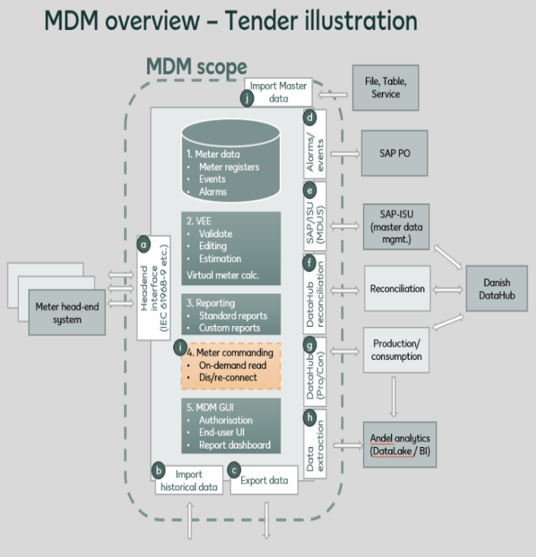
Solution Scope Summary
Solution:
Establish and configure the MDM solution and integration services compliant to the Danish market model with data exchange via the DataHub (Energinet.dk)
The MDM Solution consists of MDM System (MDMS) and Head End System (HES)
The MDMS shall include management of several separate distribution networks.
Meter Master data and Metering Point Master data are owned and managed by the external systems.
The new HES shall be able to manage Meter models already installed in Andel’s Grid.
The new HES shall cover 3.000 meters in addition to other existing HES.
The new HES shall be provided on a On-Premise solution.
Services – Implementation:
The MDMS shall be delivered as SaaS or similar service model.
The HES shall be delivered as an On-prem solution, where the Supplier develops and installs the solution in Andel’s IT environment.
Provide and install file adaptors to collect data from meter models already installed in Andel’s Grid.
The services shall include the necessary configurations of the MDM Solution.
Migration Project 1: Migrate data with audit trail also from Cerius containing data for Cerius DSO and Nakskov Net DSO. This will be a migration from IDSpecto MDM and Panda MDM including data for about 450.000 Meters. (Migration Project 1)
Migration Project 2 (Optional): Migrate data with audit trail from Radius DSO. This will be a migration from Gridstream MDM including data for about 1.000.000 Meters.
Train Andel MDM users as a part of the migration project.
Continuing Services – Operation and Maintenance:
for the MDMS System and its Integration includes support, maintenance and operation as part of the SaaS delivery (or similar service model).
for the new HES includes support and maintenance, while the Head End System is operated by Andel or a third-party supplier.
Operation of the HES is performed by Andel or a third-party operation supplier.

Slide 6
Key Challenges to meet Target Price
Target Win Price for this opportunity
Tender budget has been announced to 10.8MUSD Win price (evaluation 25% on price) need to be as low as possible, cause once in – Radius and other grid areas will follow, + extension of AMS
Methodology and data points used to arrive at Target Win Price
Client budget: 10.8MUSD For IBM Consulting, the benchmark price can be analyzed with the tool at https://w3.ibm.com/services/lighthouse/documents/170069
Key Issues / Challenges to meet target price | Actions taken during solutioning | Support Needed to achieve win price
Solution/software should not cause mark up for license price, in order to stay competitive | RASCI clearly listed in order to support direct contract between Siemens + Greenbird with Andel | Support/advise of business setup with direct subcon. contracts
One implementation per country projects, but will expand footprint from there | Required to have expertise setup from teams who have conducted delivery before (CoE for EE&U), mapped with local CIC | Ensure access to resources for tender and delivery
Partnering with three subcontractors | Building upon and further establishing good relations and successfully delivered MDMS projects with Siemens (>12 years) and Greenbird (>4 years) | If strategic partners, more support in partnering could be done – look for collaboration at other deals
Many global expertise centers involved, causing difficult to consolidate into simple, cheap setup | Work with consolidated solution setup and challenge solution, pricing, risks and assumptions | Strong, consistent core tender team
Migration of 11 years of data | Solutioning and recommendation based upon data lake and few years, and at same time showing alternatives | Solution expertise from global (Montreal/US) references support tender and presentation
Notes:
E Owner : SME

Slide 7
Business Setup (passthrough)
Advantages for Andel:
More flexibility for Andel (contract, communication)
Direct communication with partners (easier, quicker)
No risk uplift
Better price for Andel
“We help you to make it cheaper”
Contract (Andel/IBM):
IBM deliveries
Siemens deliveries (passthrough)
Greenbird deliveries (passthrough)
SMSC deliveries (passthrough)
IBM is primary partner for Andel for all communications
Andel
contract
Andel/Kalkitech
EULA, SLAs
Andel/Siemens
EULA, SLAs
Andel/Greenbird
EULA, SLAs
IBM Consulting*
Management
Services
Migration
passthrough (RASCI)*
Kalkitech**
HES license
Expert Services
Siemens
MDMS licenses
Expert Services
Greenbird
Utilihive licenses
Expert Services
Nordcloud
Utilihive licenses
Expert Services
COTS (standard products)
COTS
COTS
COTS
*further details in the RASCI
** alternative is Netinium
Passthrough can be done (according to discussion with procurement, 14.02.2023):
Then it‘s out of our project TCV
No mark-up (cost = price)
No risk or reduced risk for us
Cost will not hit the project
How can we handle this?
Passthrough means, we have no responsibility of any kind of the delivery from the partners (that‘s why we have the RASCI)
We will work as a „billing agent“ (we create one invoice with IBM logo – no further services than that) – consolidated invoice → no mark-up
Since we don‘t have to take over any risk for supplier goods and services the risk markup should be zero or very limited.

Slide 8
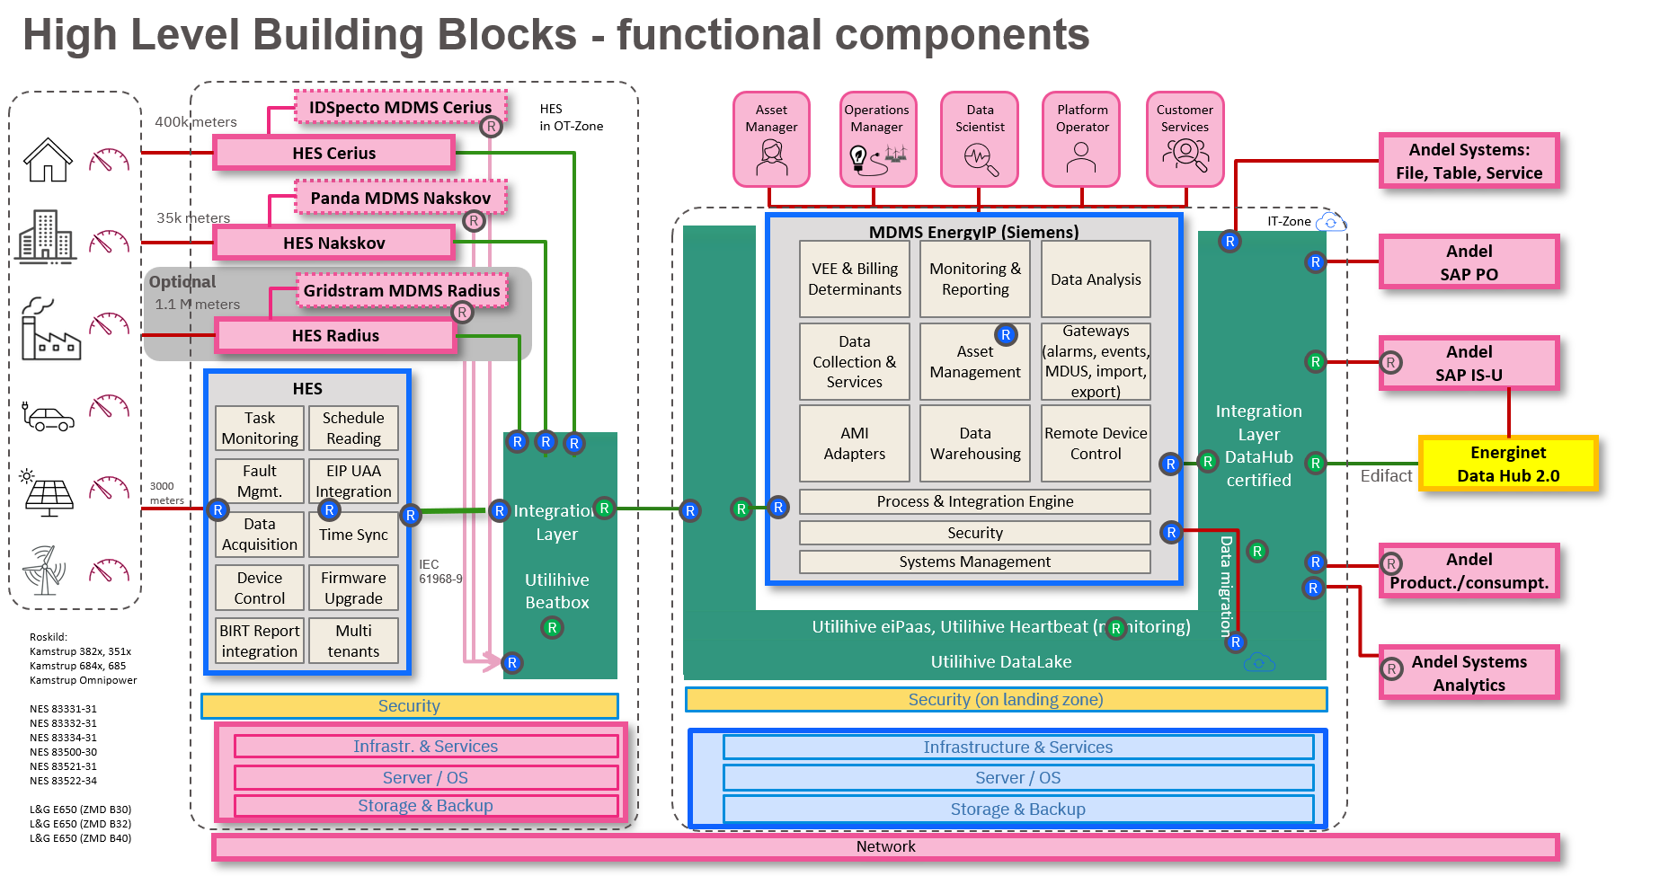
IEC 61968-09

Slide 9
Andel expects a filled price list (yellow boxes to be filled)
All prices are EURO excl. VATted
Product/Service | Description | Number of units | Level | Metric* | MDM-Project | Year1 | Year2 | Year3 | Year4 | Year5 | Year6 | Year7 | Year8 | Total | Total Evaluation Price | Evaluation weight
 |  |  |  |  | Price | Price | Price | Price | Price | Price | Price | Price | Price
MDM System | License fee / subscription | 0 - 1.500.000 | Level 1: Base level fee | Number of Meters |  |  | - | - | - | - | - | - | - | - | - | 100%
MDM System | License fee / subscription | 1.500.001 - 2.000.000 | Level 2: Add-on fee to Level 1 | Number of Meters |  |  | - | - | - | - | - | - | - | - | - | 90%
MDM System | License fee / subscription | 2.000.001 - 2.500.000 | Level 3: Add-on fee to Level 2 | Number of Meters |  |  | - | - | - | - | - | - | - | - | - | 70%
MDM System | License fee / subscription | 2.500.001 - 3.000.000 | Level 4: Add-on fee to Level 3 | Number of Meters |  |  | - | - | - | - | - | - | - | - | - | 30%
MDM System | License fee / subscription | 3.000.001 - 9.999.999 | Level 5: Add-on fee to Level 4 | Number of Meters |  |  | - | - | - | - | - | - | - | - | - | 5%
Head End System (HES) | License fee / subscription | 0 - 9.999.999 |  | Number of Meters |  |  | - | - | - | - | - | - | - | - | - | 100%
 |  | Est. Hours | Avg. Hourly rate ** | Cap
Interfaces | Development/Implementation/Configuration |  |  | T&M, Maximum price | - |  |  |  |  |  |  |  |  | - | - | 100%
Interfaces | Yearly maintenance |  |  | Fixed/year |  |  | - | - | - | - | - | - | - | - | - | 100%
Security Component (OT) | Development/Implementation/Configuration |  |  | T&M, Maximum price | - |  |  |  |  |  |  |  |  | - | - | 100%
Security Component (OT) | Yearly maintenance |  |  | Fixed/year |  |  | - | - | - | - | - | - | - | - | - | 100%
Option | Description | Est. Hours | Avg. Hourly rate ** | Cap
Interfaces - Radius | Development/Implementation/Configuration |  |  | T&M, Maximum price | - |  |  |  |  |  |  |  |  | - | - | 80%
Interfaces - Radius | Yearly maintenance |  |  | Fixed/year |  |  | - | - | - | - | - | - | - | - | - | 80%
Implementation/configuration project | Description | Est. Hours | Avg. Hourly rate ** | Cap
Governance (planning and coordination) |  |  |  | T&M, Maximum price | - |  |  |  |  |  |  |  |  | - | - | 100%
Configuration and Installation |  |  |  | T&M, Maximum price | - |  |  |  |  |  |  |  |  | - | - | 100%
Migration |  |  |  | T&M, Maximum price | - |  |  |  |  |  |  |  |  | - | - | 100%
Testing |  |  |  | T&M, Maximum price | - |  |  |  |  |  |  |  |  | - | - | 100%
Hypercare |  |  |  | T&M, Maximum price | - |  |  |  |  |  |  |  |  | - | - | 100%
Options | Description | Est. Hours | Avg. Hourly rate ** | Cap
Governance (planning and coordination) - Radius |  |  |  | T&M, Maximum price | - |  |  |  |  |  |  |  |  | - | - | 80%
Configuration and Installation - Radius |  |  |  | T&M, Maximum price | - |  |  |  |  |  |  |  |  | - | - | 80%
Migration - Radius |  |  |  | T&M, Maximum price | - |  |  |  |  |  |  |  |  | - | - | 80%
Testing - Radius |  |  |  | T&M, Maximum price | - |  |  |  |  |  |  |  |  | - | - | 80%
Hypercare |  |  |  | T&M, Maximum price | - |  |  |  |  |  |  |  |  | - | - | 80%
Consultancy |  | Hours / Year | Avg. Hourly rate **
Senior consultant | (Estimated usage - No commitment) | 100 |  | Time&Material | - | - | - | - | - | - | - | - | - | - | - | 100%
Consultant | (Estimated usage - No commitment) | 100 |  | Time&Material | - | - | - | - | - | - | - | - | - | - | - | 100%
Project Manager | (Estimated usage - No commitment) | 100 |  | Time&Material | - | - | - | - | - | - | - | - | - | - | - | 100%
Application specialist consultant | (Estimated usage - No commitment) | 100 |  | Time&Material | - | - | - | - | - | - | - | - | - | - | - | 100%
 | Total Maximum Project price excl. Options and Consultancy |  |  |  | - |  |  |  |  |  | Total Evaluation-technical price (EURO) |  |  |  | € -
*) "Metric" defines the calculation by description of the units as e.g. "Number of meters"or "Number of transactions"
**) "Avg. Hourly rate" must be calculated based on the hourly rates stated under Consultancy in row 33 .. 36
Required Scope (what we propose) (1 yr + 4 ys + 3 ys optional):
MDM Solution (MDMS + HESnew + Integration Layer) (licenses, environment, services)
Interfaces to HES IDSpectro + HES Panda
Interfaces to Backend systems
Interfaces to Datahub
Migration of IDSPectro (400k meters)
Migration of Panda (35k meters)
Integration Services (D, B, T, Hypercare)
AMS for MDM Solution (incl. interface to IDSpectro, Panda)
Optional Scope – Gridstream (what we propose):
Extension of MDM Solution (licenses, environment, services)
Interface to HES Gridstream
Extensions of Interfaces to Backend systems
Extension of Integration Services
Extension of AMS
Gridstream (migration of 1.1M meters)
AMS for MDM Solution (incl. interface to Gridstream)
In addition Andel requests prices for up to 10M connected meters
Further details, e.g. payments and price components
(deliverables, payment per milestone, …)

Slide 10




MDMS – Functional Architecture
Consumption,
history,
…
Asset health,
Asset KPIs,
…
Quality of services
Customer SLA, KPIs,
…
Analytics,
Insights,
…
Compliance,
Solution SLAs, KPIs
…
Customer Services
Asset Manager
Operations Manger
Data Scientist
Platform Operator
…
Integrated Digital Meter Meters
Collect & Control
Provide
Consume
Enterprise IoT Platform
Business Application Domain
Meter reads
Events, Alerts
measurement data
Device Management
Operational Analytics
User Interface
HES
REST, XML, ETL, https, WS, Flatfile
Enterprise Analytics
Configuration
Firmware
e.g. Asset insights, PI Data historian, Grid utilization, water flow, …
REST
JMS
CIM
LwM2M,
ETL
Relationship Management
Intelligent Automation
API & Portal
REST, XML, ETL, https, WS, Flatfile
Customer Platforms
Integrated Digital Meter Meters
Measurement values
Data Events, Alerts
e.g. Customer insights
measurement data
Meter data Management
Data Service Automation
Business Services
HES
Multi-Device Interfacing
REST, XML, WebServices, Flatfile
Billing
API, Data Provisioning
Configuration
Firmware
Alarm & Event Management
Outage Management
Logic & Rules
e.g. Billing determinants
REST
JMS
CIM
LwM2M,
ETL
REST, XML, WebServices, Flatfile
Works Management
Data Management & Archiving
Access Management
Visualiz., Monitor. & Reporting
e.g. Master data and data in motion, Outage Information
Connectivity
Interoperability
Data Security
Non-functional capabilities
Follows Open Standards
Scalable (computation, storage)
Agile and functional evolutionary
Integration into the DevOps toolchain
Supports intelligent composable business
Total experience for customers and employees
Engineering support for intelligent automation
Cloud native containerized solutions
Hybrid cloud and vendor independent
An open and multi-vendor eco system
Data always within the country
Highest level of end-to-end-cybersecurity

Slide 11
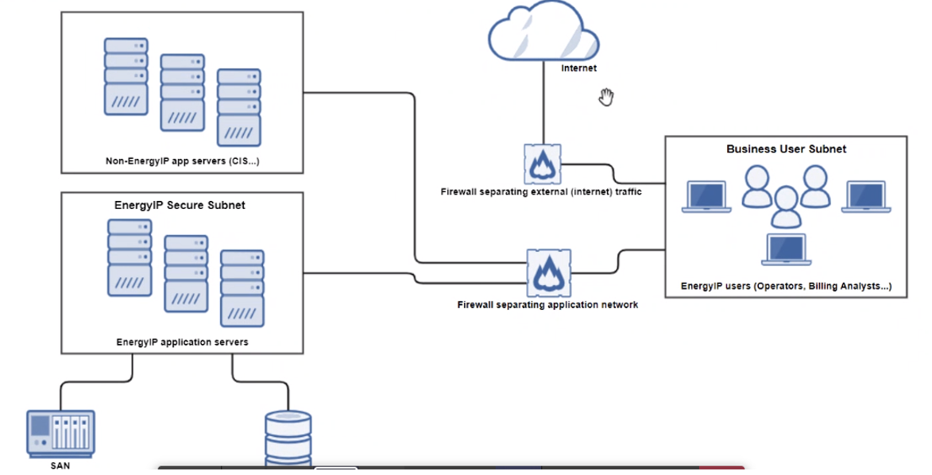
EnergyIP MDMS complies with Andel‘s Security requirements.
Security
SSO is provided with EnergyIP platform which can work with the Andel LDAP server/Directory server for authentication.
If an implementation for Andel lacks a directory server, EnergyIP does provide a fully-encrypted and secure database-based authentication mechanism.
The SSO server can be configured to work with either LDAP or EnergyIP provided authentication. In addition EnergyIP platform provides a full-feature authorization mechanism for role-based access control.
Further details: Introduction to Siemens EnergyIP Meter Data Management (MDM)

Slide 12
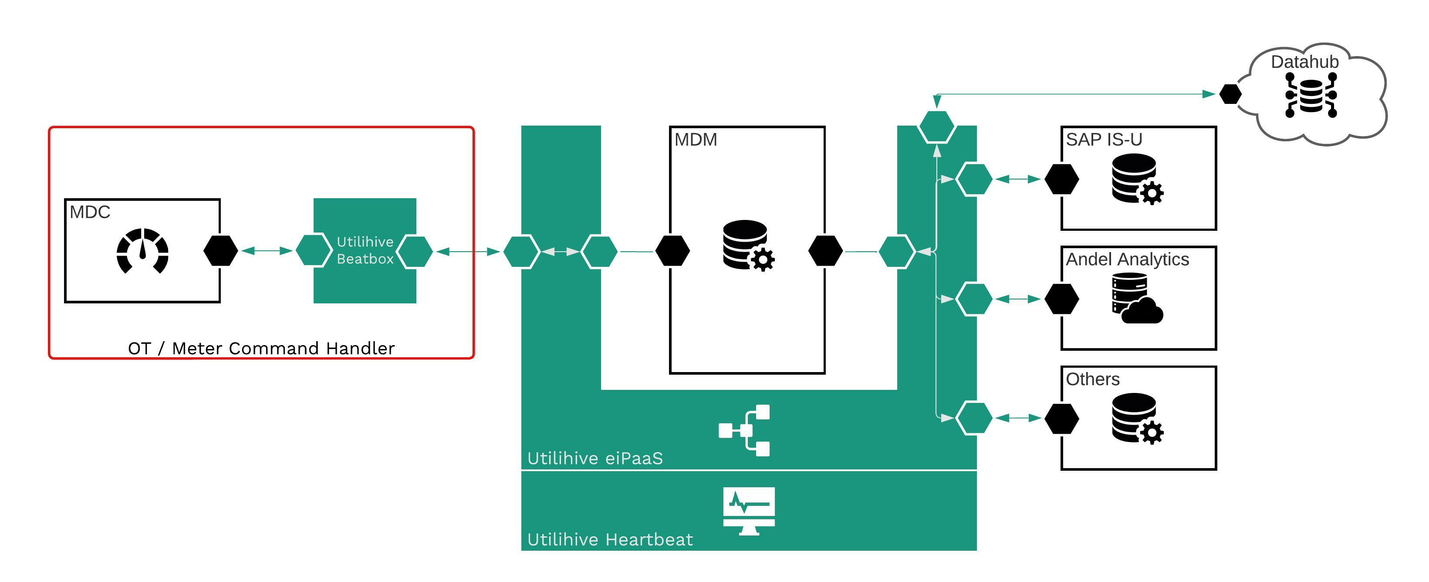
Integration with Utilihive as the choosen Integration Platform
Datahub Integration & Message Exchange
Secure OT – IT Communication for HES Integration
Proxying MDUS Messages to ensure unified Monitoring
End-2-End Monitoring for both OT and IT integrations
End-2-End Monitoring for Datahub Integrations
Greenbird Integration Technology is ISO/IEC 27001:2017 certified for Information Security Management for its Utilihive Platform.
IBM Consulting / © 2022 IBM Corporation
Notes:
Focus area 1: Meter Command Handler
Utilihive has with its Utilihive Beatbox a solution that is used exactly in the same way as a Meter Command Handler in the Danish market.
Utilihive Beatbox is deployed in OT and integrates with HES in OT. Utilihive Beatbox communicates securely with the Utilihive “mothership” deployed in IT.
Utilihive Beatbox always initiated the communication to fulfill OT security requirements.
Utilihive Beatbox receives DCT / Metering Commands from Utilihive in IT (from MDM and / or SAP) and handles the HES integration.
Utilihive Beatbox receives alarms & events and readings from HES and forwards to Utilihive in IT integrating with MDM.
All Utilihive Beatbox integrations are managed and monitored through the unified Utilihive Heartbeat monitoring system.
This solution is already today deployed and in operations for DSOs in Danmark.
Focus area 2: Datahub Integration
Utilihive handles integration with the Danish Datahub.
Integration means here, Utilihive handles message exchange and provides monitoring for that too (Utilihive Heartbeat).
Focus area 3: Integration with Andel Analytics, SAP PO and / or other Andel systems
Utilihive is used as integration layer towards those systems.
All integrations are monitored in Utilihive Heartbeat.
Focus area 4: Proxying of MDUS messages
Utilihive is used as proxy between SAP IS-U and MDM to enable unified monitoring in Utilihive Heartbeat.
With the proposed solution, we
A) leverage the out of the box capabilities of the MDM regarding MDUS integration
B) solve the OT integration challenge to deliver the Meter Command Handler
C) provide a flexible solution to integrate ANdel’s other systems in a simple way
D) solve the message exchange and integration with the Danish Datahub
E) provide with Utilihive Heartbeat one unified monitoring environment that can be used for end-2-end monitoring of all integration and flows across all systems and parties (Meter Command Handler, MDM, SAP, Datahub, etc.) that helps to
1) minimize project costs and risks during implementation
2) optimizes operations after go live.

Slide 13

Head End System support Andel’s HES requirements
Key points
On Prem deployment of the HES
Flexible: It is compatible with a diverse smart meter providers (L&G, Kamstrup, NES)
Scalable. Benchmarks available. Sized and priced for two options:
- 3000K meters
- 10 M meters
Integrates with Greenbird Utilihive Beatbox on prem through REST APIs
Head end software deployable on cloud or on-premise serves for smart meter data collection. Extension for instantaneous, load profile, billing profile and event profile data reads. Support basic Validation, Estimation and Editing (VEE) and simple REST API’s for integrating with third party applications are also build in as part of the software. Headend system is validated with most of the energy meters available in market and support inbuilt meter specific template library for various use cases.
Supports DLMS,
ANSI, Modbus, DNP3
DLMS support for
different makes and
models of meters
Support for MODBUS,
DNP3 and many more
including proprietary
protocols
Support for Advanced
Metering Capabilities
Standards based
interfaces for advanced
smart grid use cases
– TOU, connect/
disconnect, load limiting
REST based interface
to connect advanced
meter data processing
applications – MDM,
billing, analytics
User Friendly
Configuration
Simple and easy
configurations with
templates, grouping,
import-export of
meter data in excel,
etc.
Auto discovery
and registration
beneficial for large
deployments
Securing Data
Transportation
Encrypted
communication
using TLS1.2
based transport
layer security
Secured
authentication
complying to
DLMS protocol
standard
Further details: Kalkitech technical response to requirements https://ibm.box.com/s/yw9ef5xm4ncxu9nyqnuqvfwecv9lcmjn

Slide 14
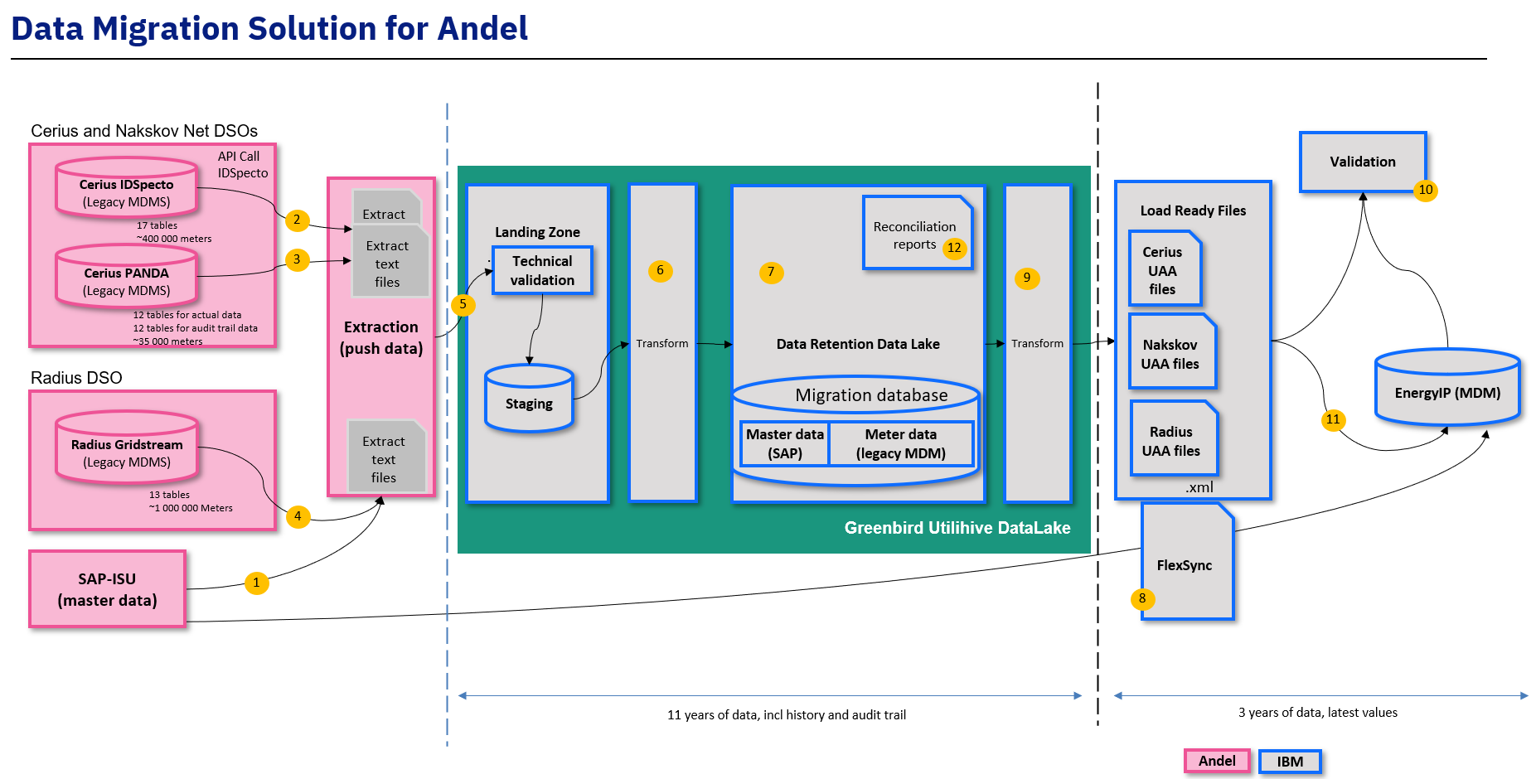
Data Migration Solution
BTS BPO | BTS Non BPO | HCT | HCM | Cloud
Notes:
Owner : SSC
1 – Metering point master data with validity time will be retrieved from SAP-ISU and loaded into the landing zone, from where this data can be used for transformation and matching to meter data from legacy systems
2 – Meter data from Cerius IDSpecto will be extracted via the IDSpecto API call and loaded into the landing zone.
3,4,5 – Cerius PANDA data, Nakskov Net MDM data and Radius Gridstream data as well as their audit trail data will be fully loaded into the landing zone.
6 – From the landing zone both master data and meter data will be transformed into a format that can be accessed for ad-hoc querying.
7 – The data retention data lake will be the repository for migrated data, it will expose data for ad-hoc querying as well as reconciliation reports.
8 – From the data lake, only relevant data that need to be in EnergyIP will be exported into UAA format and loaded into EnergyIP. Proposed time: 1 year.
9 – Validation Step taking place before data load of master data into EnergyIP - Data integrity is very important at this stage. It will be achieved through scripts to compare data in EnergyIP and data in the FlexSync to be loaded
10 - SAP-ISU – Master data is loaded into EnergyIP using FlexSync format and loading

Slide 15
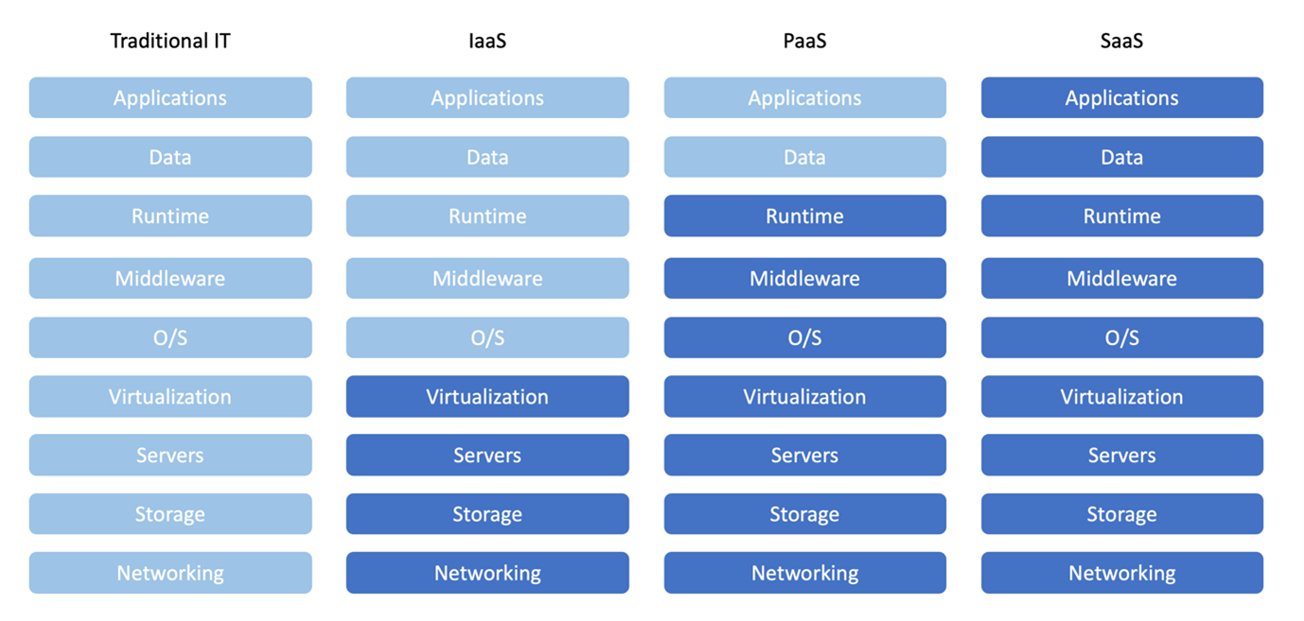
Who provides what cloud infrastructure Cloud-based MDMS and Integration solution (IT-zone), Onpremise solution (OT-zone)
EnergyIP (Siemens MDMS):
Working on a shared infrastructure
Subscription on Azure (1. project) (IBM)
Integration Utilihive, Data Lake, Heartbeat (Greenbird):
Working on a shared infrastructure
Subscription on Azure (2. project) (IBM/N)
Beatbox (Greenbird):
OT-environment on premise
IBM/Nordcloud (managed Service)
Core services to provision Siemens and Greenbird platform
Azure subscription includes Server and Storage (Infrastructure)
Sizing has been done based on different sizing documents: https://ibm.box.com/s/39parm509tmf09j87ia6soehdx9mxtn0

Slide 16
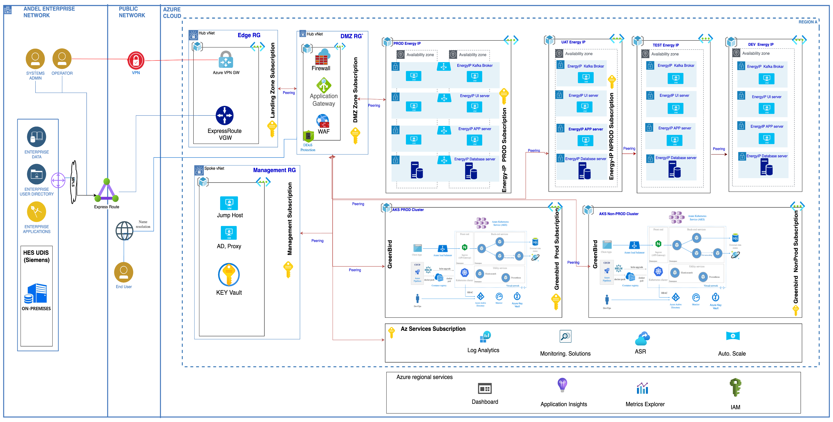
Cloud platform provided by IBM/Nordcloud

Slide 17


Use Cases that need to be supported (in scope)
MDM Solution
HES Cerius
Integration
iPaaS
Utilihive
(Greenbird)
MDMS EnergyIP (Siemens)
Integration
iPaaS
Utilihive
(Greenbird)
Andel Systems: File, Table, Service
Andel SAP PO
HES Nakskov
Andel SAP IS-U
HES Radius
Energinet Data Hub 2.0
HES new
Andel Product./consumpt.
Andel Systems Analytics
UC 1 Obtain Meter Reading Data
UC 2 Validate, Estimate, Edit data
UC 3 Calculate billing determinants
UC 4 Customer billing and invoicing
UC 5 Manage Tariff Settings on the Metering System
UC 6 Customer Move-in / Move-out
UC 7 Supplier Change
Interact consumption
UC 8 Demand Side Management
UC 9 Facilitate Demand Response Actions
UC 10 Enable and Disable the Energy Supply
UC 11 Manage Efficiency Measures at the Premise using Metering System Data
Interact Network
UC 12 Facilitate Distributed Energy Resources for Network Operation
UC 13 Manage the Network using Metering System Data
Interact Meter
UC 14 Install, Configure, Maintain the Metering System
UC 15 Manage Interference to Metering System
UC 16 Interact with Devices at the Premise
Outage & Quality
UC 17 Manage Outage data
UC 18 Manage Power Quality Data
Analytics & Reporting
UC 19 Display and report Messages
UC 20 Analyze meter reading data
Customer Interaction
UC 21 Manage customer interactions
IBM Consulting / © 2022 IBM Corporation
Details
Notes:
Focus area 1: Meter Command Handler
Utilihive has with its Utilihive Beatbox a solution that is used exactly in the same way as a Meter Command Handler in the Danish market.
Utilihive Beatbox is deployed in OT and integrates with HES in OT. Utilihive Beatbox communicates securely with the Utilihive “mothership” deployed in IT.
Utilihive Beatbox always initiated the communication to fulfill OT security requirements.
Utilihive Beatbox receives DCT / Metering Commands from Utilihive in IT (from MDM and / or SAP) and handles the HES integration.
Utilihive Beatbox receives alarms & events and readings from HES and forwards to Utilihive in IT integrating with MDM.
All Utilihive Beatbox integrations are managed and monitored through the unified Utilihive Heartbeat monitoring system.
This solution is already today deployed and in operations for DSOs in Danmark.
Focus area 2: Datahub Integration
Utilihive handles integration with the Danish Datahub.
Integration means here, Utilihive handles message exchange and provides monitoring for that too (Utilihive Heartbeat).
Focus area 3: Integration with Andel Analytics, SAP PO and / or other Andel systems
Utilihive is used as integration layer towards those systems.
All integrations are monitored in Utilihive Heartbeat.
Focus area 4: Proxying of MDUS messages
Utilihive is used as proxy between SAP IS-U and MDM to enable unified monitoring in Utilihive Heartbeat.
With the proposed solution, we
A) leverage the out of the box capabilities of the MDM regarding MDUS integration
B) solve the OT integration challenge to deliver the Meter Command Handler
C) provide a flexible solution to integrate ANdel’s other systems in a simple way
D) solve the message exchange and integration with the Danish Datahub
E) provide with Utilihive Heartbeat one unified monitoring environment that can be used for end-2-end monitoring of all integration and flows across all systems and parties (Meter Command Handler, MDM, SAP, Datahub, etc.) that helps to
1) minimize project costs and risks during implementation
2) optimizes operations after go live.

Slide 18
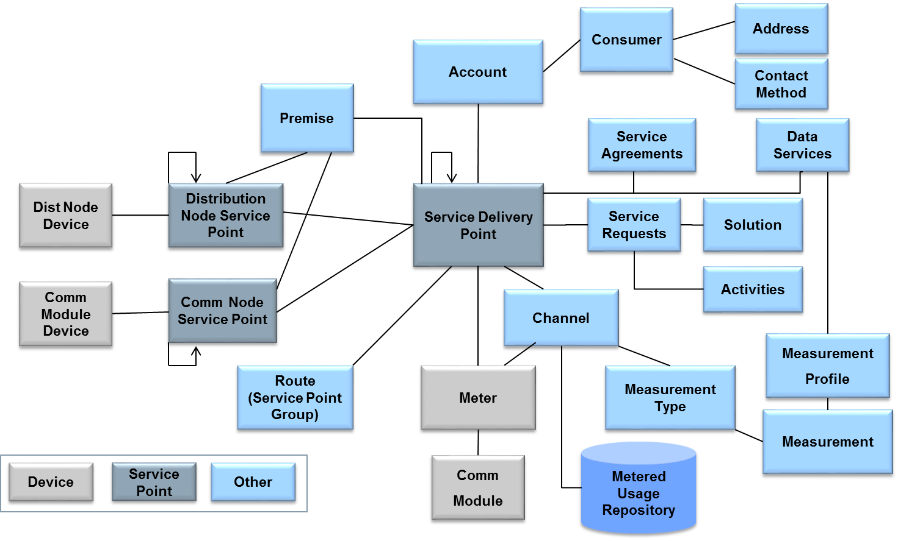
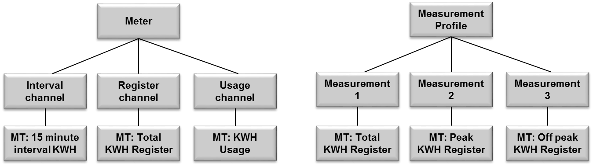
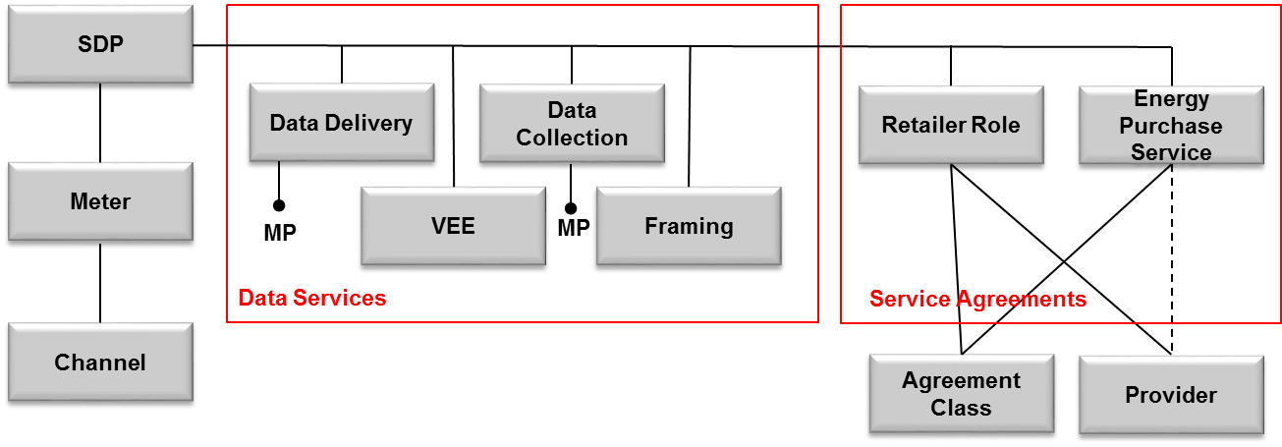
The EnergyIP Data Model supports Andels VEE, Framing, data services, data delivery and reporting requirement
Measurement, channels
Three types of channel
Interval
Register
Usage
Separate register channel for each register read, not grouped
Measurement profiles used for data delivery, data collection, and AMI adapters
Channels and measurements point to measurement types
Channel number replaces physical and logical channel number
Different service types:
Data services (DD, DC, VEE, Framing, etc.)
Service agreements (EPS, market roles)
VEE and Framing services do not point to assets. Service class holds information about what to do for different measurement types
Providers are indicated directly on service agreement record
Data Delivery and Data Collection services point to measurement profiles (MP)
Framing service class has TOU schedule info for each channel number

Slide 19
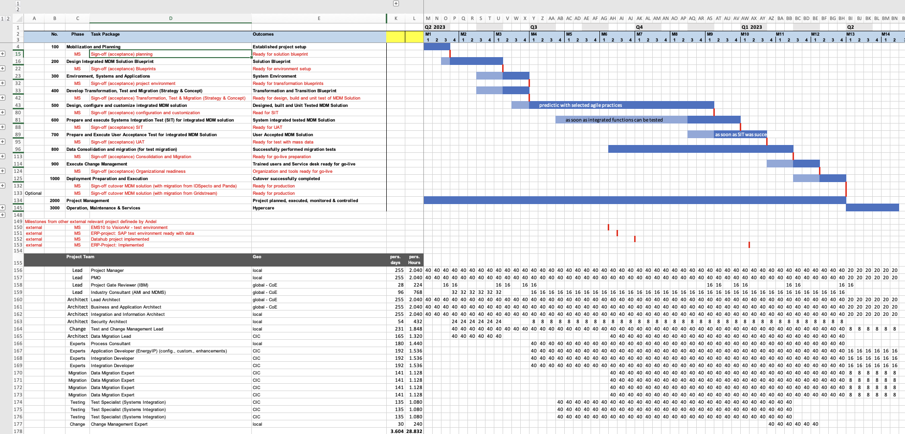
Solution Schedule - High Level Project Overview (based on Expert estimates – similar MDM Solution Projects (e.g. TPC, Entergy, Eskom)
Estimation method:
Analogous estimation (e.g. TPC, Eskom)
Expert judgment
Further planning details: https://ibm.box.com/s/qjanvs7t8xw0rubucr8fkf85fittv180
Notes:
Owner : SSC Pitched by SSC – Three Min
If this deal involves garage, then include this slide and delete the previous slide (Solution Schedule)
Keep in mind, what does the current Pricing Delegation Letter says concerning Agile and the ability to fix price or not
Remove the red oval
Include Solution Schedule Slide (Previous slide) or High Level Project Overview for deals involving Garage offering (This slide)

Slide 20
HCT
Scope Bounding Summary - Testing
In Scope
Data migration testing
API testing
Web Application Testing
System Testing (Limited Scope)
System Integration Testing
Regression Testing
Performance Testing
Test Management (All in-scope Test Phases)
Defect Management
UAT Support (IBM Test Team)
Technology
Meter Data Management/MDM System (Siemens EnergyIP MDMS and Kalk.io Head End): Web applications
Test Deliverables
Test Deliverables are per agreed project plan, Test Strategy, Test plans, Test scenarios, Test Scripts, Test Progress and Performance Report for all types of testing, Test sign off and closure reports
Not in Scope (For Test Team)
Unit Testing/application testing (By Development and application Team)
Reliability (Disaster Recovery Testing)
Security (Vulnerability) / Penetration Testing (By Security BU)
Configuration, Release, Environment Management, Infrastructure, Network
A/B Testing
No SLAs / SLOs being committed to testing
Any other testing types not mentioned under In-Scope section
Test Environment / Devices
SIT, UAT, Pre-Prod
Duration & Relationship
Design & Build Implementation : 18 Months
Delivery Model
Delivery Model: Iterative Development
Delivery Location : CIC India and CIC Romania
Total FTEs –
Estimation
Calculated hours with Bottom-Up approach based on DUCT Model
using Standard Estimation Model.
­Testing Tools & Accelerators:
IBM Ignite Quality Platform (IQP) : Web Applications : Selenium, CTD.
API Testing: POSTMAN and SOAP UI
Automation / Regression Testing – Selenium using OTFA
Performance Testing: Jmeter
Test case / Defect management : JIRA Test management / Zypher (To be confirmed)
Notes:
Owner : SSC
Include all relevant bounding and note any bounding condition that will not be included in the SOW/Contract. Unless notes, all bounding shall be in the SOW/Contract
Pitched by SSC – Three Min

Slide 21
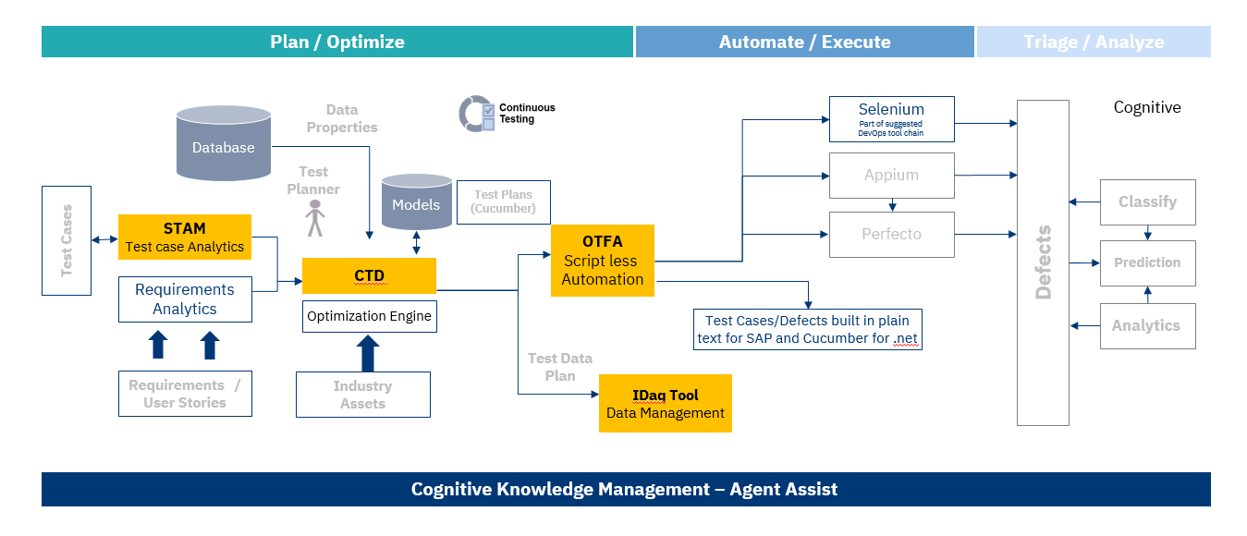
Test Approach
We use
IBM’s IGNITE framework (enables new use cases using AI)
Test Optimization (embedded within IGNITE) to create new test cases and improve test effectiveness.
Advantages:
Very high test coverage with limited number of test cases
Enables very efficient testing (especially regression testing in the project phase and ongoing testing during operations and maintenance

Slide 22
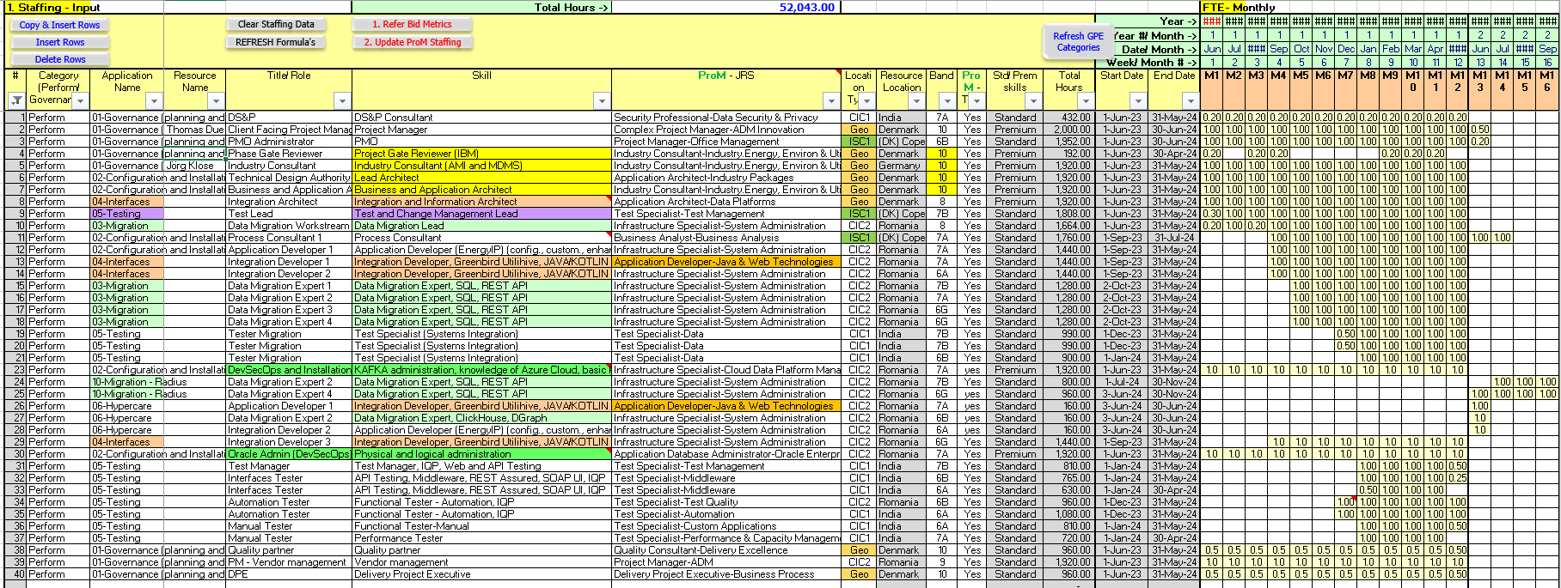
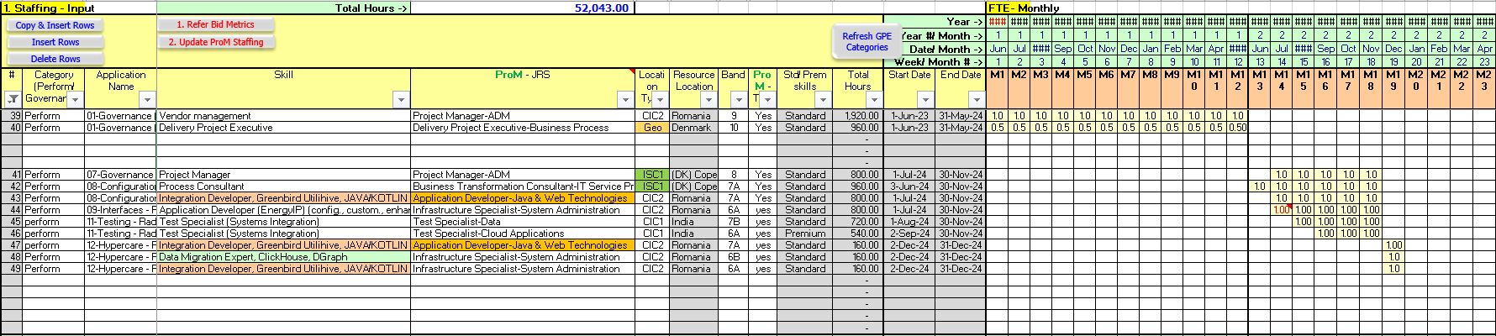
IBM Consulting Staffing: https://ibm.box.com/s/90f5wpfn08kw0ds7plnxwi7l7aftetaz

Slide 23
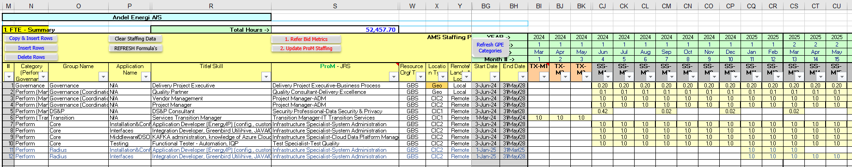
IBM AMS Staffing – Continuous Services 48 months: https://ibm.box.com/s/9jox9botavu51bhjfmi11x8bgoq7xjig

Slide 24
Project Organization
Steering Committee
Andel NN
IBM NN
Project Management
NN
Project Control Lead
NN
Vendor Management
NN
Andel Experts
Business Requirements Experts
Change Management Lead
NN
Lead Architect
NN
Migration Lead
NN
Test Lead
NN
IT Requirements Experts
Developer Andel systems
Change Analyst
Process Analyst
Infrastructure Architect
Integration Architect
Cyber Securtiy Expert
Data Migration Expert
Migration Tool Expert
Testing Expert
Test Tooling Expeert
Data Specialists
Configuration Expert
Developer
Data Intgration Expert
User Acceptance Testers
Change & Business Processes
MDM Solution Integration
Data Integration & Implementation
MDM Solution Security
Data Migration
MDM Solution Test

Slide 25
HCT
Scope Bounding Summary
Price, tender, listed as 10.8MUSD (fixed price)
Timeline/approach, listed as predictive
Milestone billing need to be adjusted
Extensive requirement listing
Open for cloud (SaaS) solution/provider
Open for service ticketing setup
Fixed, clear requirements
We provide T&C (for discussion)
Contract is in draft form (for discussion)
…
Notes:
Owner : SSC
Include all relevant bounding and note any bounding condition that will not be included in the SOW/Contract. Unless notes, all bounding shall be in the SOW/Contract
Pitched by SSC – Three Min

Slide 26
HCT
Scope Bounding Summary – AMS (Continuous Services)
AMS Scope Bounding Summary
Scope bound is done by the baselines in the tables below.
IBM will provide Level 2 and Level 3 support services
Team Sizing is based on the Baseline of Services included in the proposal. Any change in the baseline will require a Project Change Request and IBM will have to make adjustments to Staffing and consequently price
All Service Incidents and/or Service Requests will be treated in severity level order and within the same severity level, in the order received, unless directed otherwise by the client Project Manager in consultation with IBM Project Manager
Support levels defined in the Baseline of Services are planned on a monthly basis. Tickets and/or hours do not carry over to subsequent months if they are unutilized.
In the event of receiving number of problems that exceed the maximum baseline, the additional effort will be addressed as a change request in the context of baseline assessment.
AMS - Continuous Services - Core Solution
AMS - Continuous Services - Radius
Notes:
Owner : SSC
Include all relevant bounding and note any bounding condition that will not be included in the SOW/Contract. Unless notes, all bounding shall be in the SOW/Contract
Pitched by SSC – Three Min

Slide 27
Key Assumptions and Dependencies
Document | Trello card | Box folder | Document Version link from Trello Box
ADTD | 4-Solution Build-Create Assumptions and dependencies | 300 – RACI & ADTD | https://ibm.box.com/s/9ew2oxfbntoihhvyckyxqfg3ew9lfumo
Dependency | Description | External/Internal | When is it expected to be closed
Dependency | The new Head End System on-premise infrastructure will be provided by Andel | External | Pre-Contract
Dependency | Andel will provide the ITSM tool. | External | Pre-Contract
Dependency | Data extraction from the source systems is done by the client. | External | Pre-Contract
Assumption | Description | Responsibility | When is it expected to be closed
Assumption | It is assumed that that total number of meters is distributed among 20 different meter types that would require different configurations. | Client | Pre-Contract
Assumption | It is assumed that all operational reporting requirements are covered by reports included in the EnergyIP software. It is assumed that all analytical reporting requirements are covered by Andel using the data exported to the Andel Analytics Data Lake. No effort is included in the current offer for development of reports. | IBM | Pre-Contract
Notes:
Owner : SME

Slide 28
RASCI - (R)esponsible, (A)ccountable, (S)upportive, (C)onsultative, (I)nformative
Open items:
Nordcloud details in RASCI
Greebird testing activities in RASCI
Extract from detailed RASCI is available, including responsibilities of 3rd Parties and as well IBM Internal detailed responsibilities.
Full RASCI here: https://ibm.box.com/s/1gay8pzwzuni51mrnika07p3j3ea8c3a
Notes:
Owner : SME

Slide 29
Additional Solution Deviations
Standard Solution Element Explained | Deviation / Risks Explained | Reason for Deviation
Standard estimation not available. | For effort estimation a standard model is not available. However, the estimations were done using 2 estimation methods, one top-down and one bottom up. Configuration estimation is estimated top-down and crosschecked with two SMEs | Leveraged previous projects experience of the Energy and Utilities CoE. SMEs involved from similar running project with EnergyIP (Hydro Quebec, IESO and Taiwan Power)
Note : Please document those solution deviations which have not already been recorded in slide “Key Challenges to meet Target Price”
Note: Document all solutioning deviations from guidance including anything related to applicable regulations as per DPRC.
Notes:
Owner : SME

Slide 30
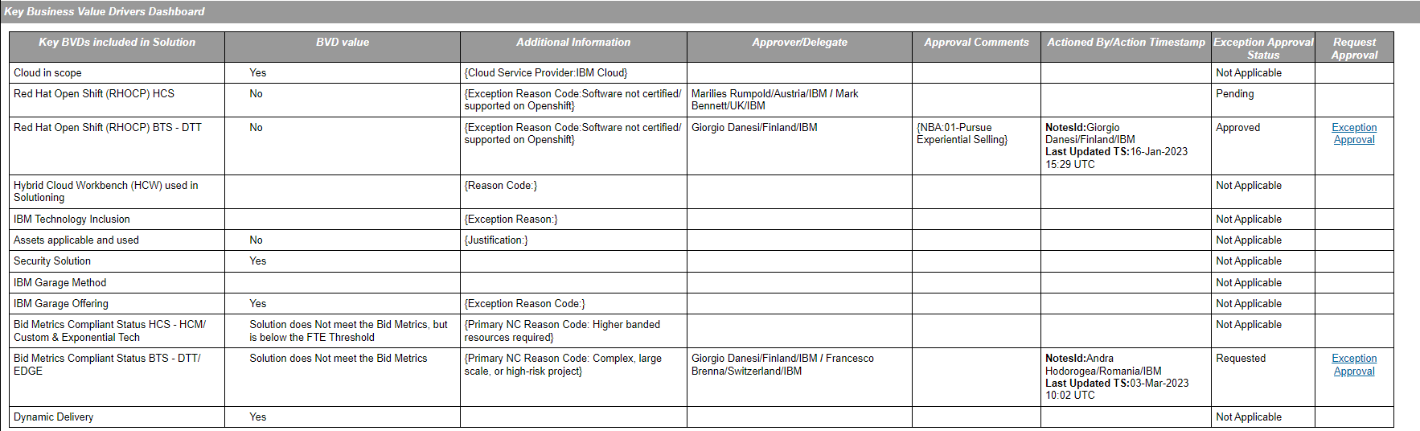
Key Business Value Drivers
Business Value Drivers (BVD) proposed for this Solution Release
Notes:
Owner : SME

Slide 31
Bid Metrics - DTT
Notes:
Owner : SME

Slide 32
Bid Metrics HCM
Notes:
Owner : SME

Slide 33
Compliance and Review Status
Compliance | Status (Y/N/NA) | Comments
Standard PM&T | Y | DTT and HCM PMT profiles created
RHOCP inclusion | N | Not applicable
Standard Estimation | N | Not available
PGR | Y | B10 included in staffing
EPL | Y | DMS estimation draft
Account Initiation | Y | DMS estimation draft
OSS | N | Not applicable
Solution Reviews | Status | Comments
Global Solutioning | Y
Staffing - GEO | Y | WIP to obtain CoE staffing comittment
Staffing - CIC | Y | All roles discussed with CICs, verbal agreement reached on band mix and roles, closing with formal email response
PS&ITS Certification (CSB) | Y | Reviewed by Cloud Solutioning Board
TDA | Y | Done with open items
Risk | Y | Done with open items
Data from the SWB
Notes:
Owner : SME

Slide 34
Notes:
Owner : TDA / ITR Pitched by TDA/ITR – Five Min *
If the deal requires an ITR, then the ITR Slide is used, with the other TDA slides included after this slide In total – 5 minutes for ITR and TDA
The slides need to be clear on what risks, who owns the risk and any requires required to be complete before submission needs to include status from the deal team.

Slide 35
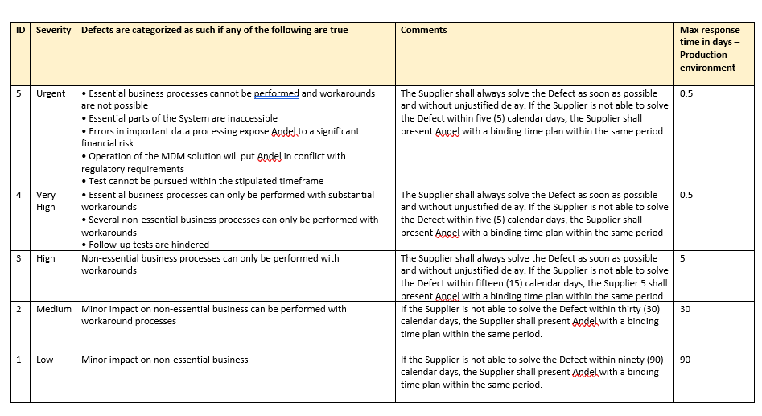
Service KPI’s & Service Levels
If Applicable
Service Levels & KPI Required
Yes | No
Existing SL & KPI in Place
Yes (SLA) | No (KPI)
SL & KPI set by
IBM | Client
RFP SLAs
Notes:
Owner: SSC Pitched by SSC – Three Min
Make sure this slide is consistent with the Deal Profile Summary – being consistent with SLA (typically have hold back / penalties), SLOs and KBIs (typically do not have hold back / penalties).
Remove the red oval

Slide 36
ACTIONS TO CLOSE BEFORE CONTRACT SIGNED
Deal Phase to Close When | Description of action | Dates and Who has the action | Status (if Applicable)
Before BAFO release | DoU and SoW with 3rd parties to be back to back; Passthrough only possible with this conditions. | OO | Draft
Before BAFO release | Perform staffing risk assessment and obtain binding staffing commitment | SSC / WFM | Initiated
Before BAFO release | Optimise price to have 28%GP for each year | Pricer / OO
Before BAFO release | Lead architect from delivery to be identified and working on the solution | OO
Before BAFO release | Close all items raised by TDA and Risk | OO
Before BAFO release | Reach agreement on TCV allocation to DTT and/or HCT for main consulting component | SSC | Initiated
Before BAFO release
Notes:
Notificatio of cccOwner : OO Pitched by OO – Three Min
Include all actions that need to be closed before we sign the contract.
For Deal Phase: First indicate when the action has to be closed and under that when was the action first defined
These will be verified at the start of delivery (Project Paunch or Phase Gate)
If help needed, articulate the action

Slide 37
Technical Delivery Assessment (TDA) for B&P submission (6/3)
TDA SME Name | TDA Risk Rating | TDA Complexity Assessment
Bert PEETERS | 7 | M
Complexity Assessment - Key Criteria | Y / N / NA
Is the solution a First-of-a Kind? | Y ⁽¹⁾
Complex System Integration Activities & Deliverables? | Y ⁽²⁾
Does Delivery involve more than IBM Consulting? | Y ⁽³⁾
Project Delivery Environment complex (3 or more locations)? | Y ⁽⁴⁾
Client Environment pose challenges (Complex / Political)? | unknown
Complex or significant Client Transformation ? | N
Any other reasons for this opportunity to be considered complex | -
Has DPRC solution been reviewed & Financials included? | Y
Does the Solution design meet the SLAs and/ or SLOs? | N
Technical Delivery Assessment Summary – Narrative / Comments
The TDA was performed based on internal documents. On 28/2 no formal proposal, DOUs or 3rd party back-to-back contracts were available. TDA RR 7 assumes that the mitigation actions listed below in blue are completed prior to submission for B&P and that the remaining actions in green will have been completed at the end of the BAFO phase.
(4) = Denmark, Romania, India
Key Risks |  |  | Mitigation
Description | Probability | Impact | Description | Close / Timing
Non-IBM-Consulting resources missing (in plan) & not committed ⁽³⁾ | H | H | Draft DOUs reflecting results of workshops, exchanged with other IBM units and third parties / plan updated / signed agreements. | Pre-B&P / BAFO
High-level architectural models might lead to misunderstandings between parties involved⁽²⁾ | M | M | Include list of environments needed both on cloud and on premises. Add setup activities to plan. Elaborate a conceptual operational model and have it confirmed by the cloud, security and test teams. E.g., validate it against the test strategy. | Pre-B&P / BAFO
Assumption that local team is up and running from day 1 ⁽¹⁾ | H | M | Add initial training to plan and cost. | Pre-B&P / BAFO
Notes:
Owner : TDA / ITR
Pitched by TDA/ITR – Five Min *
If the deal requires an ITR, then the ITR Slide is used, with the other TDA slides included after this slide
In total – 5 minutes for ITR and TDA
The slides need to be clear on what risks, who owns the risk and any requires required to be complete before submission needs to include status from the deal team.

Slide 38
Proposal Risk Assessment Summary (1/3)
Risk Managers / SMEs
Role | QA Partner | TDA SME | TDA SME (SL 2) | ITR Reviewer
Name | > unassigned < | Bert Peeters | N.a. | N.a.
Proposal Risk Assessment Summary – Narrative / Comments
Case has 3 FOAK element in the form of subcontractors with who we have not performed delivery within the Market Siemens: IBM have worked with them in Canada Greenbird: IBM have worked with them in Taiwan Kalkitech: ?? FOAK process has been initiated (1st meeting with Billur has taken place) No Subcontractor SoWs presented to QA Risk Contract is Service to Perform - T&M w/Cap (T&M w/cap defined at sub-levels) We are obligated to monitor and implement legal changes within the original scope of the solution QA Risk has not received the mandatory documents required to perform a Risk Assessment and there is no time left to perform further review and assessment of the case prior to the submission (B&P) Contractual elements which are not put into Appendix D are deemed to have been accepted by us and can not be brought into the negotiation phase. continued ….
Key Complex / Risk Elements | Y / N
FOAK? | Y
Complex Client Transformation? | N
Complex System Integration? | Y
Unclear Requirements, non-binding scope? | Y (1)
XLOB, XGeo, XDC? | Y
Non-IBM SW / HW / Services be integrated into solution? | Y
High reliance on subcontractors? | Y
Challenging Ts&Cs – contractual obligations? | Y
Challenging Client Environment? | Y
Complexity rating. NB. Approval from Sector DE is required if different to the complexity assessed by solutioning. | Complex
Are CPM, EPL & Phase Gates solutioned? EPL and Phase Gates are also required for non-complex deals | Y
Has GDPR solution been reviewed? | Y
Has the Risk Manager read the SoW / Contract / Proposal? | No
Risk recommendations
Please see the 3rd QA Risk slide
Technical Risk | RR
TDA - Project | 7
TDA – Steady State | ?
ITR | N.a.
Proposal Risk | RR (3) | Contingency
Project (+ Options) | 7 | 25%
FOAK elements (2) | 7 | 25%
NordCloud, Security | 5 | 17%
Proposal Risk | RR (3) | Contingency
MS Azure | 5 | 17%
AMS first 6 months | 5 | 17%
AMS from month 7 | 4 | 13%
Service Levels
Siemens, Greenbird & Kalkitech
The RR is not where we are now, but where we should be at BAFO

Slide 39
Proposal Risk Assessment Summary (2/2)
Proposal Risk Assessment Summary – Narrative / Comments
Andel’s Contract allow for Standard Terms, but only to the extent they do not conflict with anything in Andel’s Contract COLA & FX – COLA is regulated once a year (first time April 2024), but only based on Danish Index, so gap expected with regards to Indian and Romanian resources. FX is not part of the adjustments, we will charge Client in Euros, and QA Risk currently assume we will get the charges from Siemens in Euros, for the two other subcontractors it is an open question. The Danish currency (DKK) is closely tied to Euros, so no major FX risk with regards to Danish resources, but we have a FX risk with regards to charges from India and Romania. QA Risk do not see a tie between our Cost Driver and how we can charge the Client, e.g. Client want prices based on number of meters, while our cost from Cloud will be driven by consumption (most meters are now read by the hour, but a move towards 15-min reads is expected) “Deliver First – Settle Later” exist for both Implementation Project and in the subsequent run phase – and no caps are defined Service Levels & Penalties Service Levels are not (clearly) defined Double jeopardy - Two payment milestones have penalties for delays. If the first is delayed (M10 - Acceptance Date), then it’s also expected that the 2nd (M12 - Operational Acceptance Date) will be delayed, and therefore we will pay penalties twice for a delay of “M10” The penalty cap for these two milestones are €1.345.000 (currently lacking insight into the TCV for the implementation project) Client consider system as being down, even if is just not operating correctly. There is penalty for “end-user functions” and “MDM system”. Penalty for “end-user functions” is 0,25% of yearly fee per time, while for “MDM system” it’s 0,5% of monthly fee. Neither yearly nor monthly fee are defined, but must be expected to be the combined fee across all Service etc. Error in data sent to Datahub has a penalty of 5% of monthly fee per time if not corrected within 2 weeks, this increases to 10% if the error exist for a period of time (not clearly defined). (As the contract is written, then not sending data will also be seen as a defect leading to penalty) There is no defined cap on the above penalties (“end-user functions”, “MDM system” and “Datahub”) Penalties associated with “Services as per Order” is capped at 50%

Slide 40
Proposal Risk Assessment Summary (3/3)
Risk recommendations
The indented Delivery Architect and the Quality Partner, must be involved in the proposal work moving forward Appendix D must for this submission address areas within: Only DK based resources will be able to be onsite at Client, all others will only work remotely Standard T&Cs e.g. pertaining to Azure must overwrite Andel’s contract terms Better alignment of how we can charge Andel, based on our Cist Drivers COLA and FX for non-DK Cost Elements Service Levels to be properly defined, and penalties to be tied to the (direct) charges for the missed service – and the penalty cap to be more reasonable (aka lower) Penalty for “system down” appears to be uncapped – cap must be defined Removal of Double jeopardy T&M w/cap to be moved to top-level Carefully evaluate the terms pertaining to IP right in the Andel Contract Termination Assistance should be chargeable That we do not accept that just because the money have left Andel’s account to be the same as they have paid us (aka we have received the money) Push back on penalties to be paid from 1st day of delay – and especially as an accelerated penalty schema is defined Definition of “reasonable time” missing If we are to accept Andel assign contract to other (e.g. new) company, they must provide a parental guarantee Cap to be defined for “Deliver First – Settle Later” – and push back on even having DFSL in the Implementation Project We can not just accept to absorb impacts of delays within systems and projects on which our engagement are dependent

Slide 41
Risk Assessment
Risk Assessment Summary
# | RCA Questions | Risk Assessment | Reason
1 | First of a Kind | High | Design or Delivery resources have no experience or experienced resources cannot be leveraged for the Country/Market .
2 | Complex System Integration | Medium | The solution has a moderate amount of custom development, some interfaces, impacts legacy systems, involves some data migration and cleansing, or supports one language in addition to English
3 | Cross-Brand Delivery Management | High | There are three or more LOBs and/or GBS will be primarily be responsible for delivery
4 | Project Delivery | High | The requirements are being finalized and will be known prior to completing the solution; there is still the understanding that the requirements are achievable All TDA reviews have been completed in a detailed quality manner, however significant actions remain open or TDA review produced a high risk rating The resources have received Staff as Solutioned approval but only some are committed, or significant concerns exist about resource availability There are dependencies in delivery but IBM has control and appropriate mitigations are in place
5 | Client Environment | Medium | There are challenging client characteristics but are expected to be manageable
6 | Client Transformation | Medium | The engagement will require moderate change to the client's mode of operation
7 | Contract Terms | High | Some client responsibilities are not clearly identified and/or there is some concern regarding the client fulfilling their responsibilities. The client and 3rd party responsibilities are defined and agreed, and there is no concern regarding the client fulfilling of their responsibilities. The proposal does not protect IBM based on changes to legal regulations, client requirements or technology changes The engagement is both FOAK and fixed price and will be impacted by performance or deliverables Back-to-back not in place with key suppliers or IBM is exposed as there are not as stringent back-to-back contract terms with key suppliers as IBM will have with the client. IBM is protected by contract language, however there are limited replacements if a key supplier fails to perform or goes into default.
8 | Inclusion by Delivery Excellence | Medium | Some degree of complexity is introduced by other factors
Status |  | Draft
Complexity |  | Complex
Risk Rating |  | 9
Date:
Risk Consultant:
TDA Reviewer:
ITR Reviewer (if Req):
Quality Partner:
Delivery Partner:
CPM (if Req):
Milestone Payments:
Addtl Proj Contingency:
Scope Boundaries:
Staffing Risk:
Clear Requirements:
DOU / XLOB / XGEO:
3rd Party:

Slide 42
Risk Assessment
Risk Assessment Summary
Key Risks |  |  | Agreed\Recommended Mitigation
Description | Probability | Impact | Description | Close/Timing
High - Design or Delivery resources have no experience or experienced resources cannot be leveraged for the Country/Market . |  |  | Look to include a mitigation buffer in labour estimates and schedule Include resources from other organizations or locations that have direct experience with this type of solution to participate in solution development and delivery Ensure a TDA(s) and ITR are completed as required and the appropriate feedback incorporated into the solution Include a buffer in labour estimates and project schedule Ensure an AQL is solutioned and assigned to focus on sub-co management, dependencies, governance and monitoring, deliverables quality Ensure an AQL is solutioned and assigned to focus on technical reviews, resource /skills , governance and monitoring, proactively tagging to early warning. The AQL will drive MVP approach to mitigate FOAK risks. Ensure a Complex System Architect is assigned to the solution Ensure that a Complex Project Manager is solutioned and assigned | Prior to proposal submission
Medium - The solution has a moderate amount of custom development, some interfaces, impacts legacy systems, involves some data migration and cleansing, or supports one language in addition to English |  |  | Include resources to work on the proposal and/or participate in delivery start-up who are from other locations or organizations that have direct experience with this type of solution Ensure a Complex System Architect is assigned to the solution Ensure that a Complex Project Manager is solutioned and assigned Ensure a TDA(s) and ITR are completed as required and the appropriate feedback incorporated into the solution Identify any resourcing constraints, assignment time restrictions, specific skills and staffing ramp-up timelines to ensure they are addressed in the timeline and cost case Include a buffer in labour estimates and project schedule Ensure the contract allows IBM the ability to periodically review engagement status and propose solution and plan changes based on technology and/or data discovery Ensure an AQL is solutioned and assigned to identify integration requirements and tech. reviews as and perform complex project PM&T assessment | Prior to proposal submission

Slide 43
Risk Assessment
Risk Assessment Summary
Key Risks |  |  | Agreed\Recommended Mitigation
Description | Probability | Impact | Description | Close/Timing
High - There are three or more LOBs and/or GBS will be primarily be responsible for delivery |  |  | Ensure that Cross BL governance covers scope and dependency management Ensure as a minimum that there is an agreement in writing to the contents of a DoU prior to proposal submission and that there will be a formal DoU prior to project commencement Document scope, dependencies, governance, roles and responsibilities in a signed DOU with all BLs affected Engage a Security SME to assess the overall solution | Prior to proposal submission
Medium - The requirements are being finalized and will be known prior to completing the solution; there is still the understanding that the requirements are achievable |  |  | Ensure an AQL is solutioned and assigned to perform a deep dive review and if necessary will flag as early warning and bring in recovery focus Define the details how business/functional requirements will be measured and factored into payment schedules, if appropriate Document and review how the client's business requirements will be met and measured Ensure a change control process is defined in the SOW Ensure that requirements, as known, are reviewed and well documented and include SOW language that as requirements become more defined, the solution, costs, timeline and deliverables will be addressed through PCRs | Prior to proposal submission
High - All TDA reviews have been completed in a detailed quality manner, however significant actions remain open or TDA review produced a high risk rating |  |  | Ensure that the risk rating of the TDA(s) are updated based on the final disposition of open risks Ensure that the appropriate delivery teams have approved the deliverability of the overall solution and have reviewed the final disposition of risks and mitigations Review the open risks to either mitigate via solution updates, or when not possible, ensure that mitigations are included in the proposal and contract/SOW For exceptions to Service Line or other delivery organization standards, ensure that mitigations are put in place, reviewed and agreed by the Service Line or other delivery team to mitigate the risk to delivery For FOAK engagements in the Market, ensure that an SME from another geography with experience delivering this type of solution has participated in the TDA Have the team include open risks in the RAID log and track status prior to finalizing the solution | Prior to proposal submission

Slide 44
Risk Assessment
Risk Assessment Summary
Key Risks |  |  | Agreed\Recommended Mitigation
Description | Probability | Impact | Description | Close/Timing
High - The resources have received Staff as Solutioned approval but only some are committed, or significant concerns exist about resource availability |  |  | Ensure that the Staff as Solution plan has been approved by the appropriate areas Add a buffer to estimate for the learning curve Set up a training task for the IBM team to learn a new technology, tool or method and include effort and costs in the solution Include a cost buffer to fill critical skills from 3rd parties Ensure there is a realistic staffing plan in place and that the appropriate delivery organization is working the plan | Prior to proposal submission
Medium - There are dependencies in delivery but IBM has control and appropriate mitigations are in place |  |  | Ensure the client understands the impact to project timeline should their suppliers fail to perform Ensure a strong governance model is in place Add contractual language to protect IBM in the event their supplier fails to perform Ensure the dependencies are included in the contract and add language to protect IBM in the event the client's supplier fails to perform or dependencies impact the deliverability of the project. Ensure the contract includes language which allows IBM to claim relief for the impacts (schedule and cost) for a failed client dependency Ensure an AQL is solutioned and assigned to l institutionalize early warning mechanism that incorporates risks associated with 3rd party/client Document IBM's, Client's and supplier responsibilities and dependencies in the response | Prior to proposal submission
High - The penalties are excessive and/or not capped at a reasonable amount |  |  | Take exception to the onerous terms requested by the client and provide alternative approaches Include sufficient contingency costs to limit IBM exposure Include contractual language to cap penalties or limit IBM exposure. Other - Ensure to address the penalty calculations, cap and especially he basis for the calculations in Appendix D | Prior to proposal submission
High - The proposed blended rate card includes individual rates priced lower than 20% GP |  |  | Review the band blends by role with the service line and staffing teams and obtain their approval Use the appropriate RA based on engagement type Other - Ensure that no individuals have a GP% lower than 20% in the Pricing Case. | Prior to proposal submission

Slide 45
Risk Assessment
Risk Assessment Summary
Key Risks |  |  | Agreed\Recommended Mitigation
Description | Probability | Impact | Description | Close/Timing
Exception - There are SLAs/SLOs however the contract does not allow for SLA/SLO target changes after both the initial baseline period and periodic performance reviews |  |  | Allocate time to validate SLO/SLA Ensure an AQL is solutioned and assigned to drive quantitative project management that will help in monitoring and taking action on all key KPIs Add "walk away" language and/or repricing clause, which indicates that at the end of due diligence, if SLOs/SLAs are not agreed, we both have the ability to walk away or reprice without penalty. Add a customer responsibility to the contract to provide detailed data in support of the SLO/SLAs and reported achievement. If this is not available, institute a validation period. Other - Ensure that the issues around SLA and Penalties are cleanly addressed in Appendix D | Prior to proposal submission
High - A Complex Systems Architect is required but has not been assigned Additional risk/s selected: High - A Complex Program Manager is required but has not been assigned |  |  | Source leadership/governance resources from other geographies/organizations that have prior experience on a projects of similar characteristics Ensure an AQL is solutioned and assigned to perform contract analysis and have quality controls for supplier deliverables and milestones If a Complex System Architect was required but not included in solution design ensure that a CSA reviews the solution and/or one get assigned to the future iterations of the solution Ensure that a Service Line Leader or delivery organization leader has provided an exception for not having an experienced engagement leader on the team Include additional hours in the solution for the Partner/Associate Partner to participate in delivery at an appropriate level Include a Mentor/Complex Program Manager/Complex System Architect in the solution for at least a period long enough to start the engagement correctly or to perform knowledge transfer to the permanent delivery team | Prior to proposal submission

Slide 46
Risk Assessment
Risk Assessment Summary
Key Risks |  |  | Agreed\Recommended Mitigation
Description | Probability | Impact | Description | Close/Timing
Medium - There are challenging client characteristics but are expected to be manageable |  |  | Review a detailed RACI with the client, including any 3rd parties the client will retain Review client goals and direction to ensure alignment Review the joint governance model, management system and the Change Control, Escalation and Resolution Processes prior to contract signing Review detailed deliverable definitions and the review and approval process and timeline Ensure the contract defines conditions of success Review with the client engagement assumptions and dependencies Define clear limits of liability in the contract, including those for contract termination | Prior to proposal submission
Medium - Some degree of complexity is introduced by other factors |  |  | Other - Solution is not yet finalized and documented. | Prior to proposal submission
High - The cost case contains no or minimal costs for bonds or penalties however there's an effective earn-back clause in the agreement |  |  | Reconcile the staffing plan and staffing location with the costs and rates in the cost case Include assumptions, deliverables, roles and responsibilities and financial terms in the proposal/contract Reconcile the inflation and currency conversion methodology according to the contract Reach out to SMEs to determine if the miscellaneous costs included are reasonable and realistic Reconcile the additional cost items committed in the proposal and contract with the elements in the cost case | Prior to proposal submission
High - The cost case contains costs for bonds or penalties, however there are risks that costs will exceed the budget |  |  | Include a performance bond in the cost case if appropriate Acquire P&L executive approval for including, or excluding, performance bonds or contingency in the cost case Include contingency in the cost case for potential penalties | Prior to proposal submission
High - Other - There is risk that IBM may be exposed, and there are NOT appropriate mitigations and client agreements being put in place to allow IBM to manage the situation |  |  | Other - Ensure to address in Appendix D what will be appropriate for IBM to include to mitigate | Prior to proposal submission
Medium - The engagement will require moderate change to the client's mode of operation |  |  | Specify dependencies on the client to provide executive leadership, communication and prioritization for the Organization and Process Change Management activities Document in the proposal/SOW the client's responsibilities and ownership for implementation of Organization and Process Change Management Review IBM's role and responsibilities in this area and document in the SOW Plan regular progress reviews with the client and make adjustments to cost, staffing, solution and execute required PCRs | Prior to proposal submission

Slide 47
Risk Assessment
Risk Assessment Summary
Key Risks |  |  | Agreed\Recommended Mitigation
Description | Probability | Impact | Description | Close/Timing
High - There are disconnects between the solution and commercials and what is documented in the proposal or response with no intent or time to correct |  |  | Ensure the commercials are aligned to the solution Include in the response that the offer not open for acceptance Include the appropriate assumptions and caveats in the response to protect IBM against any gaps | Prior to proposal submission
High - Legal review is required but has not been completed |  |  | Review the risks impact of the non-standard terms to delivery and include appropriate pricing risk provisions in the cost case Take exception to the onerous terms requested by the client and provide alternative approaches Ensure contingency has been included in the cost case Include in the response that the offer not open for acceptance and/or caveat that T & Cs will need to be addressed | Prior to proposal submission
High - 3rd party obligations are not yet defined in a contractual manner Additional risk/s selected: Medium - Some client responsibilities are not clearly identified and/or there is some concern regarding the client fulfilling their responsibilities Low - The client and 3rd party responsibilities are defined and agreed, and there is no concern regarding the client fulfilling of their responsibilities |  |  | Ensure all delivery parties roles and responsibilities are clearly defined Build a matrix of the perform roles for the engagement Ensure changes to the roles and responsibilities are rolled into the solution, staffing plan, cost case and RACI Build a RACI for the perform roles and gain alignment will all parties (e.g., IBM, client, 3rd parties, vendors, suppliers) Escalate areas that the team has not been able to gain agreement Include the RACI in the proposal and contract/SOW Other - Ensure a solid draft of agreements with subcontractors - based on back-to-back principals. | Prior to proposal submission

Slide 48
Risk Assessment
Risk Assessment Summary
Key Risks |  |  | Agreed\Recommended Mitigation
Description | Probability | Impact | Description | Close/Timing
High - The proposal does not protect IBM based on changes to legal regulations, client requirements or technology changes |  |  | Review how IBM is protected if requirements were to change. If IBM is exposed, put in place a plan to address the exposure. Include assumptions in the proposal/SOW to bound scope and articulate IBM's understanding of the requirements in areas of exposure. Conduct a gap analysis to confirm scope and requirements to selected package. Include a gap analysis phase in the project timeline to validate fit/gap, and confirm work scope and effort to bridge gaps. Timebox the estimates and effort, and contain the scope to 'out-of-the-box' functionality with standard configuration, no customizations. Ensure an AQL is solutioned and assigned to drive Contract analysis and baseline the requirements, deliverables, code quality and metrics during project launch. AQL will raise the EW flag for any conflicts on changes. Other - "Assumptions" bus be formulated as baselines, prerequisites and Client Obligations. | Prior to proposal submission
Exception - The engagement is both FOAK and fixed price and will be impacted by performance or deliverables Additional risk/s selected: High - The engagement is fixed price (or T&M capped) with deliverables that will impact the payment schedule but deliverable sign-off process is unclear and/or completion criteria is not well defined |  |  | Ensure appropriate caveats/disclaimers are included in the proposal/SoW Ensure an AQL is solutioned and assigned to implement the service management framework to define the SOD , SLAs , penalties and get a sign off from the client | Prior to proposal submission
High - Back-to-back not in place with key suppliers or IBM is exposed as there are not as stringent back-to-back contract terms with key suppliers as IBM will have with the client Additional risk/s selected: High - IBM is protected by contract language, however there are limited replacements if a key supplier fails to perform or goes into default |  |  | Develop a contingency plan for alternative resources and methods to backfill the suppliers in case of default. Develop back-to-back contract with the supplier(s) Include a clause in the supplier agreement requiring the suppliers to provide IBM with detailed status and progress reports. Include step-in-rights (e.g.: Escrow, enhancements, resources, documentation) in the event of default or failure to perform If applicable, ensure that additional guarantees (e.g., financial undertaking, parental guarantee) are provided by the supplier. Develop KT plan to upskill available IBM staff to complete the work in the case of non-performance by the supplier. | Prior to proposal submission

Slide 49
BTS BPO | BTS Non - BPO | HCT | HCM | Cloud
Section : Contextual Slides
< Please remove slides not relevant for this opportunity>

Slide 50
BTS BPO | BTS Non BPO | HCT | HCM | Cloud
Solution Design / Architecture Overview
Architecture Design owned by:
Client | IBM
Design / Architecture Principles
{outline the key principles in solution design/architecture}
( Context Diagram )
Logical Architecture Diagram
Physical Architecture Diagram
( Component Diagram )
( Component Interaction Diagram )
( Key Process Flows )
Notes:
Owner : SSC

Slide 51
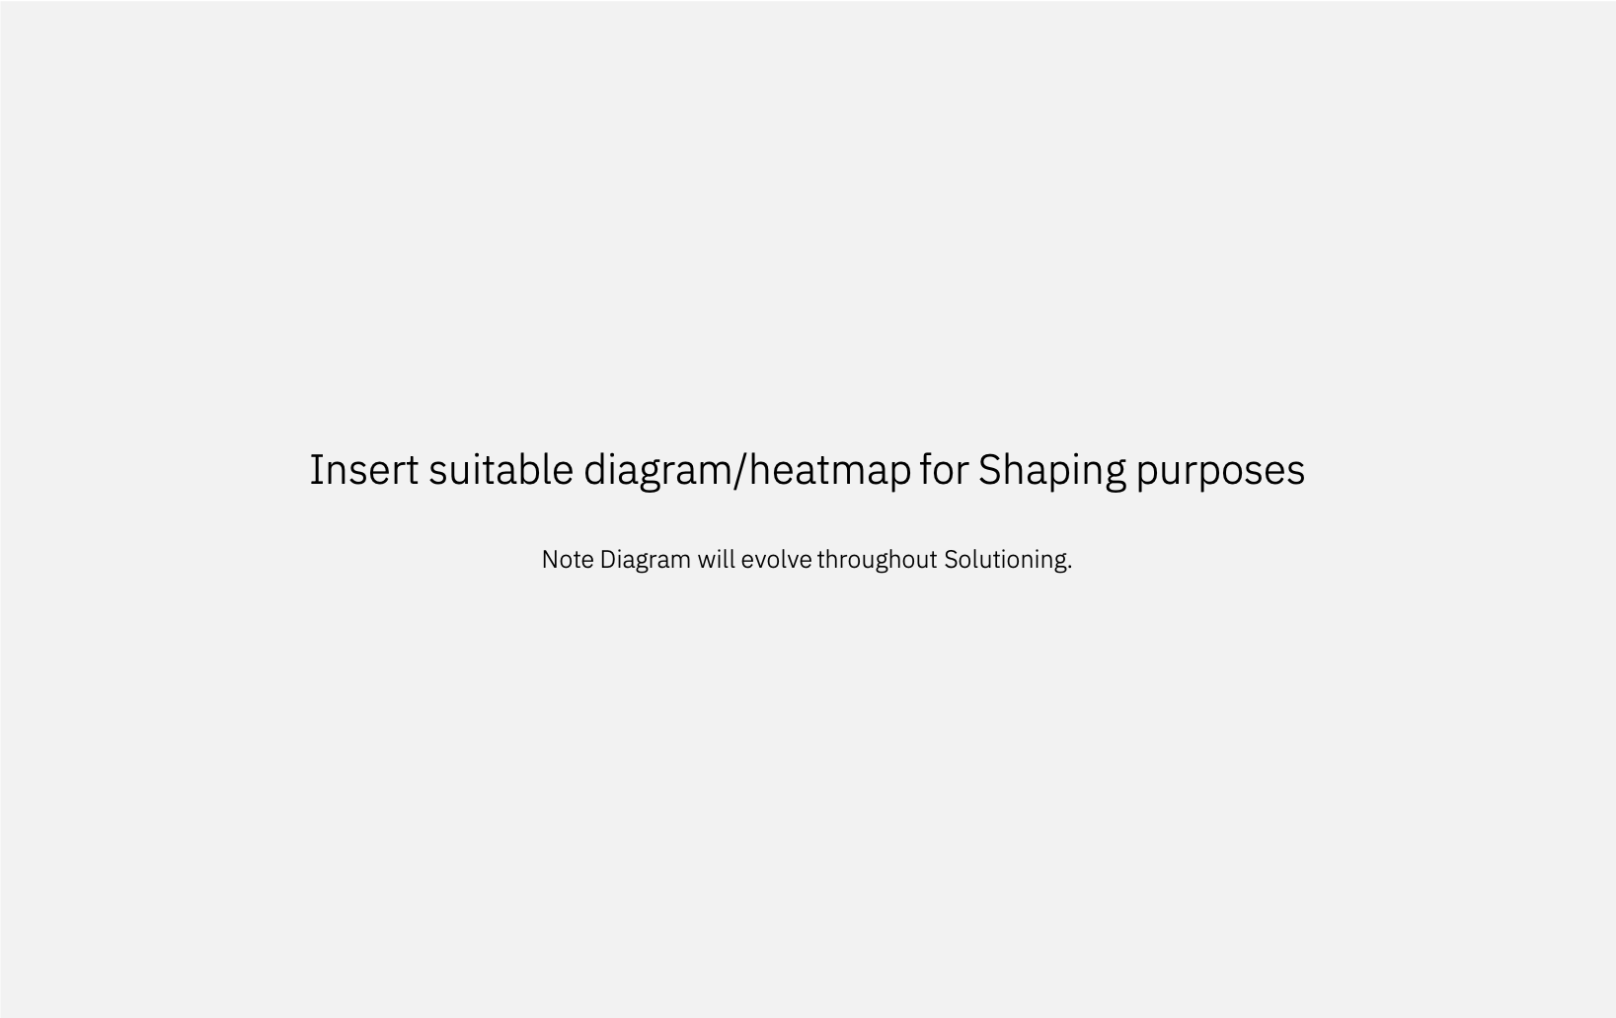
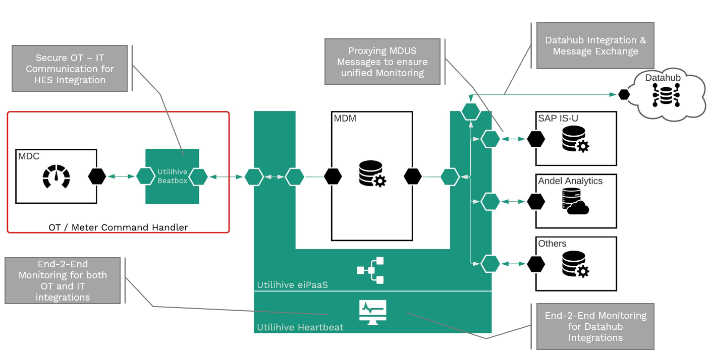
BTS BPO | BTS Non BPO | HCT | HCM | Cloud
Tbd From Greenbird?
Integration Architecture – Principles & Diagram
Architecture Design owned by:
Client | IBM
Integration with Greenbird Utilihive
Design / Architecture Principles
{outline the key for integration architecture}
Component Interaction
Protocols
Mode of Interaction
Error, Audit Handling
Notes:
Owner : SSC

Slide 52
Estimation Approach / Model / Assumptions
BTS BPO | BTS Non BPO | HCT | HCM | Cloud
Governance, Configurations – estimated top down based on SME experience from CoE Energy &Utilities (Joerg Klose); Estimation crosschecked with SME from IESO Canada (Carl Gruden)
Migration – bottom-up estimation based on parameters such as no of tables, data volume (Andra Hodorogea); Crosschecked with SME from Hydro Quebeq Canada (Andre Marcoux) and SME from Siemens in Canada (Amos Tsikayi)
Integration – bottom-up estimation based on Utilihive standard spreadsheet (estimated by partner, buffer added for IBM resources mobilization);
Testing – Data Testing bottom-up estimation based on parameters including number of transformations, number of tables and columns; Integration and functional testing estimated bottom-up from requirements.
Radius optional component – bottom up for integration and migration; estimated as a percentage of core implementation.
Top down estimation spreadsheet
https://ibm.box.com/s/ibv6oni1oxbejzg7w87mb7qj6l6qi6jc
Notes:
Owner : SSC

Slide 53
Project Deliverables
BTS BPO | BTS Non BPO | HCT | HCM | Cloud
Andra/Thomas - One option: look at the plan in detail (column E) and summarize
https://ibm.box.com/s/qjanvs7t8xw0rubucr8fkf85fittv180
List not complete. Tab deliverables in the estimation spreadsheet: https://ibm.box.com/s/ibv6oni1oxbejzg7w87mb7qj6l6qi6jc
Project Phase | Deliverable Name | Is it a Billing Milestone – Y/N? | Acceptance Criteria
1. | Migration Design Document
2. | FlexSync files and master data loaded into Energy IP for 3 years
3. | UAA files and data loaded into EnergyIP for 3 years
4. | Configurations in EnergyIP
5. | Data Lake loaded with complete data for 11 years.
6. | Training Strategy document
7.
Notes:
Owner : SSC

Slide 54
Testing
BTS BPO | BTS Non BPO | HCT | HCM | Cloud
draft
No | Testing | Responsibility (IBM / Subk / Client) | Entry & Exit Criteria
1. | Functional Tests Transaction Flow & Business Process Audit & Control Error Handling Interface/Intersystem Usability | IBM
2. | System Test System Integration Tests | IBM
3. | Performance Test Response Time Stress and Volume Test | IBM
4. | Security – Penetration Test & Vulnerability Test | IBM
5. | UAT – Functions, Business Process, Usability | IBM
6. | Disaster Recovery Test | IBM
Notes:
Owner : SSC

Slide 55
Data Migration Scope and Responsibilities
BTS BPO | BTS Non BPO | HCT | HCM | Cloud
No | Data Migration Scope | Responsibilities (IBM / Subcon or Customer) | Risks & Mitigation Actions
1. | Data Source Who determines ? If there is conflict, who decides? What if data source is not available? | Customer
2. | Data Extract and Formatting who develops scripts? who provides computation formulae? | Customer | Customer to push the data in a format that IBM can pick up and load into staging
3. | Data Cleansing | Customer | Customer is responsible of data cleansing at the data source side
4. | Data Transformation | IBM
5. | Data Input Format | IBM
6. | Data Loading | IBM
7. | Data Validation | IBM | Technical validation is responsibility of IBM
8. | Historical Data – to be converted & loaded | IBM
9. | Third Party Data | NA
10. | Data from other sites / countries | NA
Notes:
Owner : SSC

Slide 56
Data Migration Solution
BTS BPO | BTS Non BPO | HCT | HCM | Cloud
Notes:
Owner : SSC
1 – Metering point master data with validity time will be retrieved from SAP-ISU and loaded into the landing zone, from where this data can be used for transformation and matching to meter data from legacy systems
2 – Meter data from Cerius IDSpecto will be extracted via the IDSpecto API call and loaded into the landing zone.
3,4,5 – Cerius PANDA data, Nakskov Net MDM data and Radius Gridstream data as well as their audit trail data will be fully loaded into the landing zone.
6 – From the landing zone both master data and meter data will be transformed into a format that can be accessed for ad-hoc querying.
7 – The data retention data lake will be the repository for migrated data, it will expose data for ad-hoc querying as well as reconciliation reports.
8 – From the data lake, only relevant data that need to be in EnergyIP will be exported into UAA format and loaded into EnergyIP. Proposed time: 1 year.
9 – Validation Step taking place before data load of master data into EnergyIP - Data integrity is very important at this stage. It will be achieved through scripts to compare data in EnergyIP and data in the FlexSync to be loaded
10 - SAP-ISU – Master data is loaded into EnergyIP using FlexSync format and loading

Slide 57
Data Migration Solution explained
BTS BPO | BTS Non BPO | HCT | HCM | Cloud
Andra
1 – Metering point master data with validity time will be retrieved from SAP-ISU and loaded into the landing zone, from where this data can be used for transformation and matching to meter data from legacy systems
2 – Meter data from Cerius IDSpecto will be extracted via the IDSpecto API call into a format ready for entering the landing zone
3,4 – Cerius PANDA data and Radius Gridstream data as well as their audit trail data will be extracted into a format ready for entering the landing zone. E.g. csv
5 – Meter data from Cerius, Nakskov Net (data managed by Cerius) and Radius DSOs will be fully loaded into the landing zone.
6 – From the landing zone both master data and meter data will be transformed into a format that can be accessed for ad-hoc querying.
7 – The data retention data lake will be the repository for migrated data, it will expose data for ad-hoc querying as well as reconciliation reports.
8 – From the data lake, only relevant data that need to be in EnergyIP will be exported into UAA format and loaded into EnergyIP. Proposed time: 3 years.
9 – Validation Step taking place before data load of master data into EnergyIP - Data integrity is very important at this stage. It will be achieved through scripts to compare data in EnergyIP and data in the FlexSync to be loaded
10 - SAP-ISU – Master data is loaded into EnergyIP using FlexSync format and loading mechanism.
11 – UAA files are loaded into EnergyIP for period of 3 years.
Notes:
Owner : SSC

Slide 58
Data Migration Solution Pros&Cons
Pro
Contra
Reduced complexity and error handling
Full migration of the audit trail of the legacy system
Ad-hoc access to Time Series audit trail data, Master data audit trail and Formula audit trail
The new MDM system is not overloaded with historical data (impact on sizing and cost of the new system)
Relatively easy integration of optional migration of Radius DSO data, including audit trail data.
Solution designed for reusability; other data sources can be relatively easily integrated into the Data Retention Data Lake.
The solution can be extended to export UAA format for load into EnergyIP
New MDM system can be deployed for the new meters and data migration is not a critical component of the go-live
Historical meter data will not be available in the new EnergyIP system for all 11 years
Requires a either a front-end tool (e.g. reporting tool) for access or access via scripting (e.g. SQL)

Slide 59
Solution Summary
BTS BPO | BTS Non BPO | HCT | HCM | Cloud
Solution Scope
This is fixed price proposal where bottom up estimation approach based on DCUT was followed.
Contract starting from Q2 2023 – 96 months (48 months + 3 times 12 month, optional).
Application maintenance and support L2&L3 and Minor enhancements are in scope
Staffing
Denmark Domestic, CIC Romania, CIC India are considered as delivery centers
6.32 FTE total effort required to support current scope.
6.02 CIC resources and 0.3 Denmark Domestic resources are considered in the solution.
Governance
0.3 FTE Denmark Domestic are considered.
DS&P per guideline from DPRC checklist
PM full time for entire duration of contract.
Hours of Support
9X5 regular support for maintenance.
24X7 On call support for Sev1 & Sev2.
Timeline
Services Transition from March - May 2024
Steady state from June 2024 to May 2028
Optional – 3 additional years (1+1+1) from June 2028 until May 2031
Transition
Services Transition only
Service Levels:
As per SLA slide.
Other costs
Oncall related charges
Mobile phone charges
Rotation Cost for perform FTE
No Network cost included in the solution, existing setup will be used
Any type of travel cost is pass through to the client
Productivity
Productivity not applied due to small team size
Bid Metrics Compliant: Solution does Not meet the Bid Metrics, but is below the Threshold
CIC: 6.02
Near Shore: 0
Local: 0.3
AMS Delivery Locations
Offshore: CIC Romania, CIC India
Denmark Local
Security / GDPR
GDPR – applicable
Security – applicable
Notes:
Owner : SSC

Slide 60
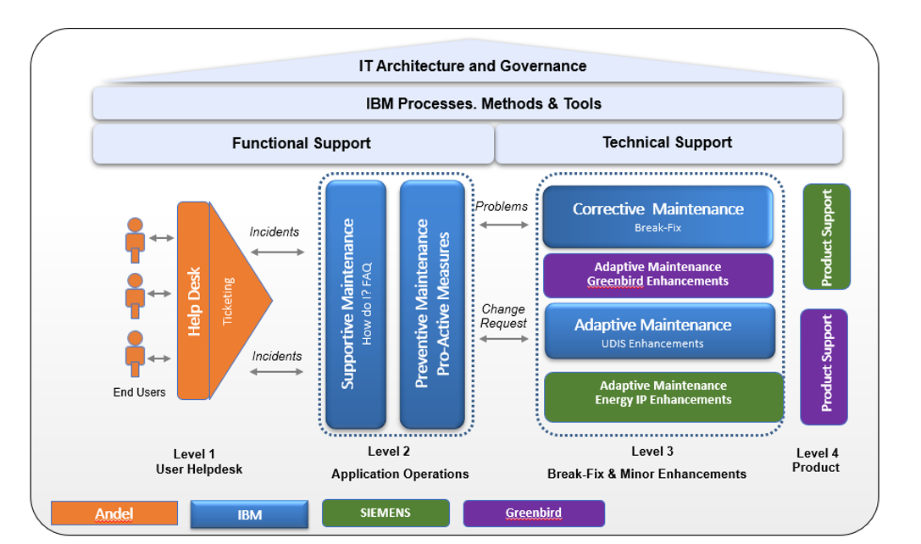
AMS Delivery Model
BTS BPO | BTS Non BPO | HCT | HCM | Cloud
Notes:
Owner : SSC

Slide 61
Service Levels Definition
BTS BPO | BTS Non BPO | HCT | HCM | Cloud
Level 1 – Support
Level 1 Help desk is the point of contact between end users and the support team. The Level 1 help desk answers all service calls initially. Level 1 is expected to resolve all calls that require process or ‘how to’ answers and correcting data. They would also be responsible for creating tickets in the helpdesk ticketing system.
The following activities are performed by the client Level 1 Support Team:
Receiving requests from end users
Analyzing and verifying the request
Providing answers to repetitive How-to questions based on FAQ
Initiation of incident ticket
Analyzing tickets and dispatching help desk
Resolving and closing help desk tickets
Forwarding the logged tickets to second level
Severity classification as per the severity definition
Closing tickets after requester confirmation or negative confirmation
Level 1.5 – Support
Level 1.5 Support team is a bridge between the Level 1 Helpdesk and the Level 2/3 development/SME teams. Level 1 Helpdesk primarily receives the first call from any business users and/or console messages. Issues which cannot be resolved by Level 1 Helpdesk are passed on to Level 1.5 Support team. This team consists of members that are not only catch and despatch resources but have some basic functional/technical knowledge to understand, analyze and resolve the issues of lower complexity or that are repeatable in nature. When Level 1.5 team cannot resolve an issue or when it gets issues which need great in-depth analysis or major code changes, the Level 2/3 teams are involved.
Level 2 – Supportive Maintenance
The supportive maintenance is a service intended to answer functional “how-to” questions that cannot be answered by the client Super Users as well as to perform data management activities.
The main activities of the supportive maintenance services can be described as follows:
Incident acceptance, classification and tracking
Providing guidance to the client on the complex functional questions or questions which The client cannot answer
Providing recommendations for FAQ updates
Performing non code related application configuration activities. Such activities are mainly administration activities that do not need any code changes.
Level 2 – Corrective Maintenance
The corrective maintenance service contains all activities and support to identify, detail and solve reported incidents such as functional defects and malfunctions in the project done by IBM implementation team on the system.
The main activities of the Corrective maintenance services can be described as follows:
Problem acceptance and tracking including classification of problems as per the severity classification
Organization and coordination of problem handling together with IBM Application Maintenance Delivery Team Lead and the client as necessary;
Problem analysis including involvement of the Infrastructure team, IBM development team for the IBM developed enhancements.
Performance of required tests (only unit testing) on development system
Maintain application, system and operation documentation as well as involved tools and asset lists
Level 3 - Corrective Maintenance
The corrective maintenance service contains all activities and support to identify, detail and solve reported incidents such as functional defects and malfunctions in the project done by IBM implementation team on the system.
The main activities of the Corrective maintenance services can be described as follows:
Problem acceptance and tracking including classification of problems as per the severity classification
Organization and coordination of problem handling together with IBM Application Maintenance Delivery Team Lead and the client as necessary;
Problem analysis including involvement of the Infrastructure team, IBM development team for the IBM developed enhancements.
Performance of required tests (only unit testing) on development system
Maintain application, system and operation documentation as well as involved tools and asset lists
Notes:
Owner : SSC

Slide 62
Service Levels Definition
BTS BPO | BTS Non BPO | HCT | HCM | Cloud
Level 3 - Adaptive Maintenance (Enhancements)
IBM uses the Adaptive Maintenance Model to provide for minor new configuration or custom development updates, additions, and deletions within existing modules and functionality that is already in production. This model is intended for simple small to medium efforts that will be completed in a single deployment effort, and is not intended for complex projects or those requiring multiple phases of development and deployment. IBM works with the client to define the criteria to be used in categorizing a service request as an Enhancement (e.g. functionality change or extension).
The main enhancements activities can be listed as follow:
Conducting impact analysis
Estimating the development effort required
Determining the impact on system performance and batch schedule
Developing the solution design and scope, based on requirements
Obtaining the client approval and prioritization of the project
Developing and changing code or configuration based on agreed-to design
Applying code to and/or configuring the development system
Performing testing as defined during the development of the testing guidelines
Completing program documentation
Obtaining user acceptance
Creating or modifying user training materials, as required
Training users, as required
Promoting the code from test into production
Level 4 - Preventive Maintenance
The preventive maintenance service covers Basis activities and services to monitor and analyze trends in order to identify potential problems and to recommend appropriate initiatives to improve the application and the operation of the same.
The main preventive maintenance activities can be listed as follow:
Enterprise System Administration
Batch Management
Interface Management
Consistent monitoring, diagnostics and treatment of problems across the The client modules and infrastructure
Analysis of ticket trends and creation of recommendation for sustainable improvements
Analysis of system monitoring report and development of recommendations for sustainable improvements
Effort estimations for improvement recommendations
Participation in release planning for the recommendations
Definition of the preventive maintenance: The Preventive Maintenance covers all activities involved to ensure proactively the performance and reliability of the solution. Whenever the support team identifies a potential threat to the application or a potential for a performance improvement an application patch is provided containing code changes to achieve the targeted improvements.
Minor Enhancements
IBM uses the Enhancements model of IBM Unified Method Framework to provide for minor new
configuration or custom development updates, additions and deletions within existing modules and functionality that is already in production. This model is intended for small to medium efforts that will be completed in a single deployment effort and is not intended for complex projects or those requiring multiple phases of development and deployment.
Minor Enhancements are changes up to 40 hours per unit. IBM typically provides a ‘bucket’ of hours (80 hours) per month for Minor enhancement activities. It comprises of configuration or custom development updates, additions and deletions within existing modules and functionality that is already in production. This model is intended for small efforts that will be completed in a single deployment effort.
Any code change over and above this threshold is considered as Projects and it is typically handled via Change Requests.
Notes:
Owner : SSC

Slide 63
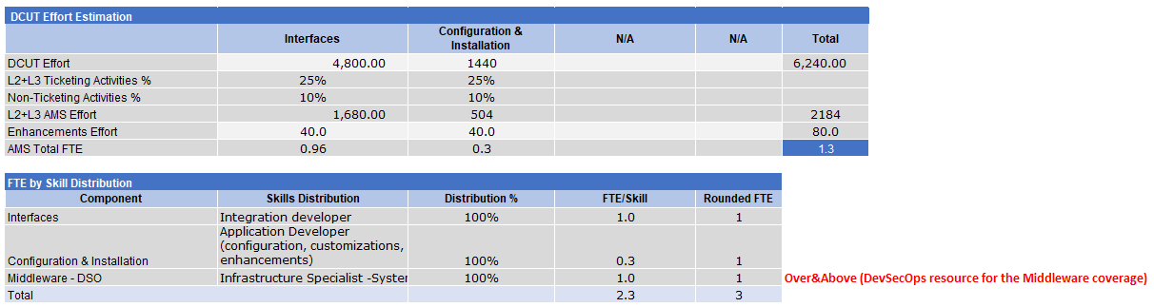
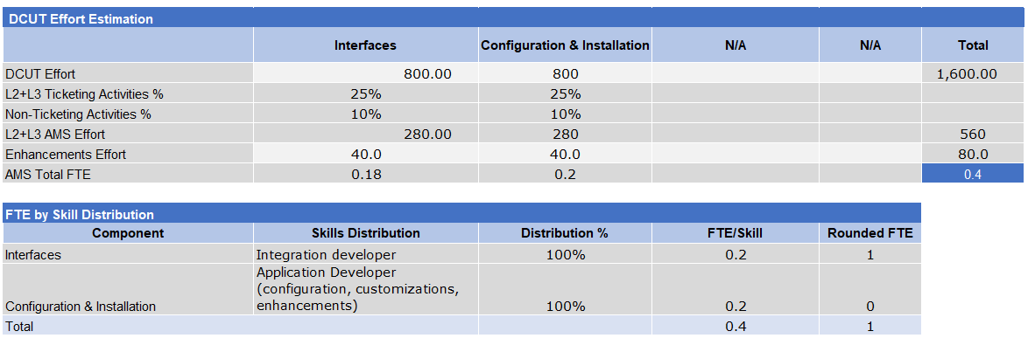
Estimation Approach / Model / Assumptions
BTS BPO | BTS Non BPO | HCT | HCM | Cloud
Core Estimation
Radius Estimation
Bottom-up estimation spreadsheets: https://ibm.box.com/s/1z8snqqykqjzgng2sgqdf69hqwsbj7u1
Notes:
Owner : SSC

Slide 64
Incident & Service Request Analysis (as applicable)
BTS BPO | BTS Non BPO | HCT | HCM | Cloud
Not applicable (new implementation)
Notes:
Owner : SSC

Slide 65
Non-Ticketing Activities
BTS BPO | BTS Non BPO | HCT | HCM | Cloud
Non-ticketing activities are included in the estimation model as 10% of the DCUT effort
User Query – Effort spent on answering questions from authorized users to provide application consulting, investigate problems to determine the cause of failure and develop an effective and efficient solution to the problem.
Monitoring - Continuously monitor the availability and health of the applications. Maintain surveillance using tools and provide immediate response to problems with constant support through problem resolution.
Service Request - Formalized through usage of Requirements Management and Service Request tool to satisfy situations where there are a small number of new requirements or a small number of errors to correct which take a minimum amount of time to complete.
Meetings - Operational level day-to-day interactions focus on the provision of consistent, high quality service delivery.
Problem Management - Regularly survey Incidents to identify re-occurring Problems, validate that Problem resolution and corrective actions taken are sufficient to confirm that the Root Causes identified do not re-occur in same or similar environments.
Notes:
Owner : SSC

Slide 66
DevSecOps Solution
BTS BPO | BTS Non BPO | HCT | HCM | Cloud
Following is the scope for DSO MW services
Support – 9X5 from Romania on call 24X7 on week days and weekends
Out of scope for DSO:
JDK, Browsers and Application COTS Software will be installed by BTS impelmentation team
MW(Oracle and Kafka) and application monitoring on cloud will be taken up by Nord Cloud
Application deployment using CI/CD
On prem MW monitoring set up is Andel responsibility
Logical database administration
MW license procurement is taken up by deal team
 | HES
 | Instance Count - On - Prem |  |  | Remarks | Install | Manage
 | Non-Prod | Prod | DR | Prod and DR in Active Active
Oracle 12C Enterprise edition with Partitioning licence | 1 | 1 | 1 |  | DSO | Andel
Redis 6.0.9 | 1 | 1 | 1 |  | DSO | Andel
Kafka 2.13-2.5.0 | 1 | 1 | 1 |  | DSO | Andel
Tomcat 8.5.28 | 1 | 1 | 1 |  | DSO | Andel
 | Siemens - Energy IP
 | Instance Count - On - Cloud |  |  | Remarks
 | Non-Prod | Prod | DR | Prod and DR in Active Passive
Oracle 19c - Oracle 12.2.0.3 | 1 | 2 | 1 |  | NordCloud | NordCloud
Apache Kafka 2.7.1 includes Apache ZooKeeper 3.5.9 | 1 | 5 | 5 | Monitoring set up is done by NC end to end from App to Platform | DSO | DSO
Assumptions:
Solution is based on the BoM provided. Any change to volumetrics will need re-estimation
Andel will provide connectivity to on-prem env
Andel will manage MWs on prem and monitor them.
AMS team will cross train on MW skills(Kafka) and support the 24X7 on call support during the run phase. This is agreed with AMS team.
Oracle Admin with both physical and logical admin skills to e considered during build phase by HCT team. Agreed with HCT team
Notes:
Owner : SSC

Slide 67
SOC Scope Summary
BTS BPO | BTS Non BPO | HCT | HCM | Cloud
Services:
Triage incidents to the right resolver groups(AMS, Security , MW teams and NordCLoud teams) – L1.5 command center team
Governance for ISM using standard reports
Work with the resolver groups to facilitate RCA
Perform base incident diagnosis / analysis to determine resolution organization and assign incidents to the right resolver groups
Preliminary technical and functional diagnosis of application issues, based on SOP provided by project team or using operations analytics tools
Act as first responder to L1.5 incidents and respond within the agreed response time SLO
Validate input quality on tickets before assigning to other teams
Incident Review and Closure (process checks, data completion checks etc.)
Execute high severity incident management communication process for application related incidents
Bridge management for all high severity incidents
Update severity 1 and 2 incidents in collaboration channels (like Slack) for the project team and client
Coverage – 16X5 from Romania remaining hrs will be on call support
Tools:
Andel has ServiceNow.
Andel ServiceNow will be integrated with IBM Europe ServiceNow for bi-directional flow of tickets
The integration for the above is factored into the solution. Cost is based on no.of users. If the no.of users changes the cost will change.
IBM Europe ServiceNow will be integrated with Nord Cloud Jira for Bi-directional flow of tickets and alerts. Cost for this integration is not included as it will be taken up by service line as part Europe ITSM changes.
Volumetrics Assumed:
No.of Tickets/Alerts to be triaged per month – 150/Month (100 tkts+50 Alerts from monitoring tools)
No.of ServiceNow user – 20 Users
Assumptions:
Andel will provide connectivity for ServiceNow to ServiceNow integration
Andel will provide SME support during ServiceNow integration
Notes:
Owner : SSC

Slide 68
SOC - Out of Scope and Assumptions
BTS BPO | BTS Non BPO | HCT | HCM | Cloud
Scope Covered by NordCloud
NordCloud will set up end to end monitoring for application, MW and platform using NC DataDog
All monitoring alerts will flow into NC PagerDuty for event correlation.
Correlated event are logged into NC Jira. NC L1.5 team will triage the Application, Security and MW alerts into IBM ServiceNow queue via NC Jira to IBM ServiceNow integration.
This approach is agreed with Nord Cloud team
Assumptions:
Andel will provide connectivity for ServiceNow to ServiceNow integration
Andel will provide SME support during ServiceNow integration
Notes:
Owner : SSC

Slide 69
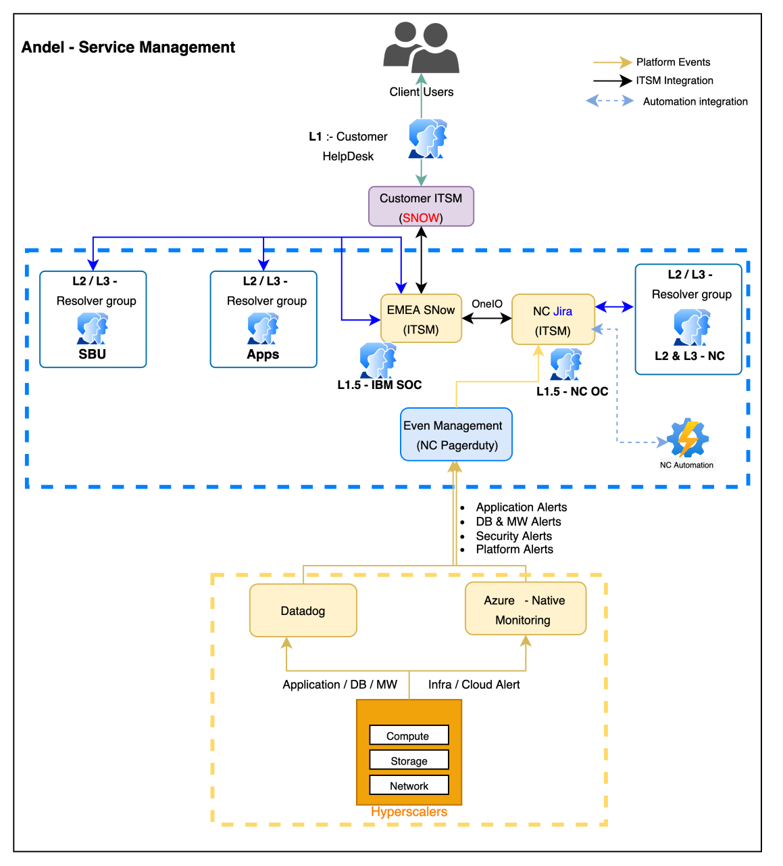
SOC Scope Summary
BTS BPO | BTS Non BPO | HCT | HCM | Cloud
SOC scope or IBM Europe Shared team
Notes:
Owner : SSC

Slide 70
SOC Cost
BTS BPO | BTS Non BPO | HCT | HCM | Cloud
 |  |  | Build | AMS
Activity | OTC(USD) | MRC(USD)- 4 Years(Y2-Y5) | Y1 | Y2 | Y3 | Y4 | Y5 | Y6-Optional | Y7-Optional | Y8-Optional
SOC L.5 Support |  | 73872 | Design build phase | 18468 | 18468 | 18468 | 18468 | 18468 | 18468 | 18468
ServiceNow Integration and onboarding | 20,000 |  |  | 20,000
ServiceNow Support |  | 192000 |  | 48000 | 48000 | 48000 | 48000 | 48000 | 48000 | 48000
Total | 20000 | 265872
SOC is for all 4 years for AMS plus 3 additional optional years
Above costs should be priced through GPE
DSO Europe team will create a DOU with account team once the deal is signed
8-12 weeks lead time is required for DSO Europe team to onboard shared resources
Notes:
Owner : SSC

Slide 71
Productivity Levers: Applied & Net Productivity – Not applicable due to small team size
BTS BPO | BTS Non BPO | HCT | HCM | Cloud
Applicable Productivity Levers: Link for Productivity Guidance and Calculator
<Please print the output from Productivity Calculator tool >
This chart is mandatory as it shows the Net Savings along with Productivity % applied for each Lever.
Please also provide justification for changing the proposed Productivity Levers.
Productivity % and Cost Included in the Solution
 |  | Applied Productivity |  |  |  |  |  | Savings
No | Productivity Levers | Y1 | Y2 | Y3 | Y4 | Y5 | Total Cost of Productivity | Cost Saved | Net Save
1 | Cognitive - Agent Assist - (COG3)
2 | Cognitive - Self Heal
3 | Cognitive - Tech Assist
4 | Cognitive - SAP Coding Assist
5 | Dynamic Automation - BP / AA
6 | Dynamic Automation - WinAuto
7 | ECA - Custom
8 | ECA - EA
9 | HCM Tools
10 | AD Tools
11 | Devops – HCM
12 | DevOps - AD
13 | Agile – HCM
14 | Agile - Development
15 | Continuous Delivery Transformation ( AQL )
16 | Future Producivity
17 | Next Gen ADM Development Factory
18 | CTD ( Combinatorial Test Design )
19 | Document Analytics
20 | STAM (Search Tag and Model )
21 | STeF (Automation )
22 | CTD+STeF+OTFA
23 | CDA, Classify, Predict
24 | CI ( Testing )
 | Sum | 0.0% | 0.0% | 0.0% | 0.0% | 0.0%
 | Compunded Sum | 0.0% | 0.0% | 0.0% | 0.0% | 0.0% | $0.0 | $0.0 | $0.0
Justification for changing the proposed Productivity Levers
* This table need to be copied and pasted from the “ProdandCostinSolution” tab of Productivity Calculator
Notes:
Owner : SSC

Slide 72
Staffing and Approvals
BTS BPO | BTS Non BPO | HCT | HCM | Cloud
Delivery Locations * | Band Mix | Staffing % | Who Approved | When Approved | Status
CIC – India - Testing |  | < % resource> | Ignatius A Hubert | 03.03.2023 | Approved
CIC – India – Testing Data |  | 4 FTEs | Manish Kumar Bhatia - Manish.Kumar.Bhatia@ibm.com | 01.03.2023 | Approved
CIC – Romania – AMOS |  | 8 FTEs | Alexandru Bighiu | 03.03.2023 | Approved
CIC – Romania – Java |  | 1 FTE | Mihai Pavelescu | 01.03.2023 | Approved
CIC – Romania – Oracle |  | 1 FTE | Lucian Murgoci | 03.03.2023 | Approved
CIC – Romania – DecSecOps |  | 1 FTE | Alexandru Bighiu | 03.03.2023 | Approved
CIC – Romania – Testing |  | 1 FTE | Laurentiu Vrabie | 03.03.2023 | Approved
CIC – Romania - PM |  | 1 FTEs | Cosmin Pacurar | 03.03.2023 | Approved
Nearshore – CIC DK |  | 7 FTEs | Signe.Birgitte.Schmid@ibm.com | 02.03.2023 | Approved
CIC India - Transition |  | 1 FTE | Balasubramanya R Subbarayalu | 22.02.2023 | Approved
Local |  | 1 FTE | Jesper Braum Nielsen / WFM Ramalinga Reddy <ramreddy@in.ibm.com>
Energy & Utilities CoE (Geo) |  | 3 FTEs
Demand already in PMP | R&CM Assessment | Staffability Review Date | Staffability Expires | Submission type
No | No |  |  | B&P
Key Resourcing Risks | Mitigations
Description | Description | Included in Price Case | Contingency Dollars | Close / Timing
Test resources in Romania do not have IQP skills | Added one month mobilization period for the resource to upskill on IQP | Y |  | Pre-proposal
CPM not available in CIC | Staff CPM from GEO DK, Thomas Due undergoing CPM certification to continue this opportunity in delivery | Y |  | < Pre-contract >
 |  |  |  | < Pre-delivery >
 |  |  |  | < In Delivery >
Notes:
Owner : SSC Pitched by SSC – Three Min
* Include one line for each delivery location
If the deal is at 65, then all staffing is approved – highlight any risks that have not been addressed in the solution – For Example: If staffing needs 3 months to get staff, and contract award and contract start are the same day, then the risk is around ability to get staff – DO NOT ASSUME the SRR executives have opened the risk files
NOTE:
Staffability approvals(s) expires 30 days after the price is released
Re-approvals and mitigations and contingency dollars included in price case during BAFO submissions
Any deals with project start date within: 4 weeks from submission or 12 weeks for GR onsite/offshore positions or from submission need to have all mitigations closed or costs included in the price case
SSC/OO shall include detailed staffing for deals with more than 50% of slots unassigned when start date is less than 4 weeks time

Slide 73
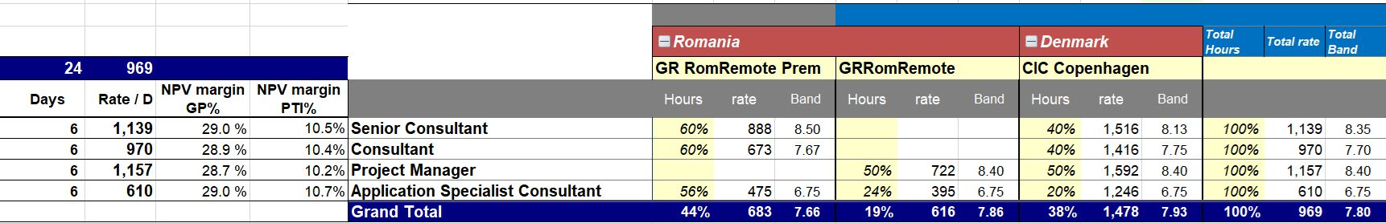
BTS BPO | BTS Non BPO | HCT | HCM | Cloud
Ratecard Solution Overview
Overview
Staff augmentation services – Application development, Enhancements, maintenance and Support
Rate card required for participating in staff. augmentation services
Offshore(India), Landed (from India) and USA local and CIC rates
11 Months rate card ( Feb 2021 – Dec 2021)
Standard Forex and Inflation assumed
Payment Terms: 30 days arrears
Standard IBM office facility for India staff and Client office for onsite staff
Regular working hours assumed for US and India
Risk rating – 3 (Low)
4 Rates
Landed
Offshore
US Local ( Travel & Living will charged on actual )
US CIC
GP Guidance: As per location wise guidance
Flat rates for the duration of the contract
Payment terms – Bill arrears, net 30
Support Coverage
General Shift only. Other shifts were not considered as part of pricing.
Shift charges will be billed on actuals.
SLA’s – None
Non-Labor –
Notes:
Owner : SSC

Slide 74
Security Solution including DPRC (as applicable)
BTS BPO | BTS Non BPO | HCT | HCM | Cloud
Please refer below link for the CAI ADM Security Guidance
Security Guidance for CAI ADM
For DPRC –
Include the scope elements relevant for DPRC
Check the Solution Design Guidelines. (please refer to respective technology Solution Guidance deck).
Use the Relevant DPRC Reference Architecture
In case of deviation, it has to be approved by the DPRC approver.
Added on 1st Jan 2022: Compliance to ITSS Chapter 5 requirements
** SPbD (ITSS Chapter 5) applies to solutions involving IBM customized client application development activities where client contract does not explicitly include custom secure development practices specified by the client that the client requires IBM to use in place of IBM’s own practices.
Please confirm the following
Please confirm if a standard method cannot be embedded in the PM&T profile, you have included the following statement in iSBD/ ADTD: “IBM Consulting development team would follow “Secure Solution” work practice as defined in Method Workspace.” You can fill up NA only if client requires IBM to use their security practices in place of IBM’s own security practices. | NA
Please confirm that all the tools required to support secured dev process have been included in the solution as per Point 3 on this Link? You can fill up NA only if client requires IBM to use their dev tools in place of IBM’s approved tools. | Y
Please confirm that your effort estimation has considered in scope items as per Point 4 on this Link? Estimation CoE or SL SME involved in the solution would be providing clear guidance on how to do this effort estimation. You can fill up NA only if client is taking care of those items. | Y
Notes:
Owner : SSC

Slide 75
DPRC Inclusions for regulation: GDPR
BTS BPO | BTS Non BPO | HCT | HCM | Cloud
Existing DPRC Assessment & TOMs
Yes | No
Links to DPRC exhibits/artefacts
DPRC Wizard: https://ibm.box.com/s/qo00b7nnidasmrcjtwaycmblla5ep5k4 DPRC estimator: https://ibm.box.com/s/ir7mhspxbxnursctzgphwwmkt9tq18pn → Url Link → Url Link
PI/SPI Data Handling Responsibility
Processor | Controller | Both | None
Question | Answer | Answer Comments
Are Custom Services being delivered in addition to the Standard IBM Services? | N | {list the custom services outside of the GTS, Cloud and IBM Consulting standards Embed Custom Services TOMs/DPA Exhibit onto this slide if they are in scope}
Are Regulatory Consultants engaged to support DPRC applicable regulation? E.g. GTS GDPR Engagement Regulatory Support/Ireland/IBM | Y | Ole Rudolph, Morten Hansen
We will use Standard IBM Terms embedded in the Contract, in accordance with standard Cross LOB Guidance with Standard Services separated from Custom Services. | Y | {Explanation if Standard Terms are not used (see Guidance) or not separated from Custom Services TOMs}
Are we using IBM TOMs or Client TOMs? | Client | https://ibm.box.com/s/qeen5gddbh1zq1ar68m5juj0i5blxqyn https://ibm.box.com/s/ka74zhghm2xx1e6q5x8d0em4fympsfar
Are we using the Standard Custom Services TOMs for Lead LoB? | Y | {Please explain, and identify the Lead Brand (GTS/IBM Consulting/Cloud)…}
For each of the Standard Services, provide the link to the Data Sheet / DPA Exhibit Used in the client contract, or explain why they aren’t used; |  | Provide the link to the Standard IBM Content, (shared with OO). Confirm it is referenced in the contract.
What actions/provisions are being taken to handle DPRC/SPI related information exchanged in virtual working environment?
Notes:
Owner : SSC

Slide 76
PS&ITS Key Opportunity Team and Delivery Leaders
Key Opportunity Team Members
Key Delivery Leaders
IBM Consulting – PS&ITS
Cloud Solution Lead (PS&ITS) | Gobinda Saha
PES Solution Consultant (NC)
DSO Solution Consultant
Cloud Sales Lead
Cloud Technical Sales
Software Sales Lead
Software Technical Sales
Other
Target Cloud | IBM cloud
IBM Technology (Public Cloud, Cloud Pak and Sustainability Software)
Cloud Customer Success Manager (CSM)**
IBM Cloud Solution Engineering, if applicable (ICSE)
Software Customer Success Manager (CSM)
Cloud Pak (ICSE)
Other
Notes:
To be completed by CSL
** In the scenario where there is no CSL assigned SSC must provide the CSM name

Slide 77
BTS BPO | BTS Non BPO | HCT | HCM | Cloud
Solution Summary: System Context
Solution Scope :
Andel (Distribution) wishes update and merge systems, and therefore acquire a new Meter Data Management/MDM Solution which will be integrated in Andel’s IT enterprise system landscape, service the Cerius distribution area (400K meters) + 2 small areas.
This Solution based on Azure IAAS- Multi region deployment on Azure cloud included the below :
Nordcloud team will design, build & manage the platform on Azure cloud environment .
DevSecOps team will manage the database & middleware, operation centres.
Azure Cloud Solution for Andel
Security
Operations
Platform build and manage
Infrastructure
Network
Workload
Custom Application
Azure Cloud
ER
Pen tests
Vulnerability tests
Incident response
SRRM
Transit Gateway
VPN
Resiliency
High availability
Azure VM
Database
Oracle DB
Backup & restore
Disaster recovery
Middleware
Kafka broker
Notes:
Owner : CSC

Slide 78
BTS BPO | BTS Non BPO | HCT | HCM | Cloud
Solution Summary: Solution Aspects and Domains
Aspects | Domains
Application | Data and AI | Edge | Blockchain | Mobile | Business Automation | Enterprise Applications*
Data | Integration | Governance | Analytics | Databases | Reporting & Visualization
Compute | Bare Metal Servers | Virtual Servers | Virtualization | Containers | Serverless | Cloud Foundry
Storage | Primary Storage | Backup | Archive | Data Migration
Networking | Enterprise Connectivity | Segmentation | Cloud Connectivity | Load Balancing | Content Delivery Network (CDN) | Domain Network Services (DNS)
Security | Data Security | Identity & Access Management | Application Security | Infrastructure and Endpoint | Threat Detection and Response | Governance, Risk & Compliance
DevOps | Build & Test | Delivery Pipeline | Code Repository
Resiliency | Backup | Disaster Recovery | High Availability
Service Management | Monitoring | Logging | Auditing / Tracking | Alerting | Event Management | Management/ Orchestration
 | Domains Taxonomy from Architecture Framework
 | Domains considered in solution to address customer requirements
Notes:
Owner : CSC

Slide 79
Solution Summary: Key Functional Requirements
Gobinda (WIP)
FR# | Category | Requirement | Traceability
FR1 | Business requirement | Contains the ultimate goal, such as an order system, an online catalogue, or a physical product. It can also include things like approval workflows and authorization levels. A business rule relates to the way an organization or company operates. In addition to applying to individuals, business rules might apply to general corporate behavior or business processes. | Business rules describe what you may or may not do in a specific business scenario. It also gives the criteria, conditions and exceptions for making these decisions e.g., Data must be entered before a request can be approved.
FR2 | Authentication | Authentication of a user when a user tries to log into the system. They are what the user of the system can do, such as place an order or browse the online catalogue. | e.g., The system must block users from access to shared folders if they don't have the necessary security credentials
FR3 | Audit Tracking | How to track any changes affecting the systems | Audit tracking allows you to fully track any changes affecting your system, capturing not only the changes occurring within Executive Series but also external changes as well
FR4 | Certification Requirements | Your organization might require certifications to work on the system | e.g., Security Certifications
FR5 | Reporting Requirements | This section of requirements will tell you how users can search and retrieve data | The users should be able to search for items or product available in the system
FR6 | Historical Data | How to save historical data, you will have a growth of data if your database is dynamic, so you need to define storage requirements to accommodate these data. | Retention of client specific historical data
FR7 | Legal or Regulatory Requirements | Are there requirements you need to satisfy for compliance? These are laws, regulations from the government, and even internal policies that the organizations and their systems must follow. | e.g., Payment Card Industry Data Security Standard (PCI DSS), Health Insurance Portability and Accountability Act (HIPAA), Federal Information Security Management Act (FISMA)
FR8 | Authorization levels | Security requirement to ensure that users can access only certain functions within the application | Only administrators can access administrative functions.
FR9 | Cost Optimization | The Cost Optimization pillar includes the ability to run systems to deliver business value at the lowest price point. | Implement cloud financial management,Adopt a consumption model,Measure overall efficiency,Stop spending money on undifferentiated heavy lifting Analyze and attribute expenditure.

Slide 80
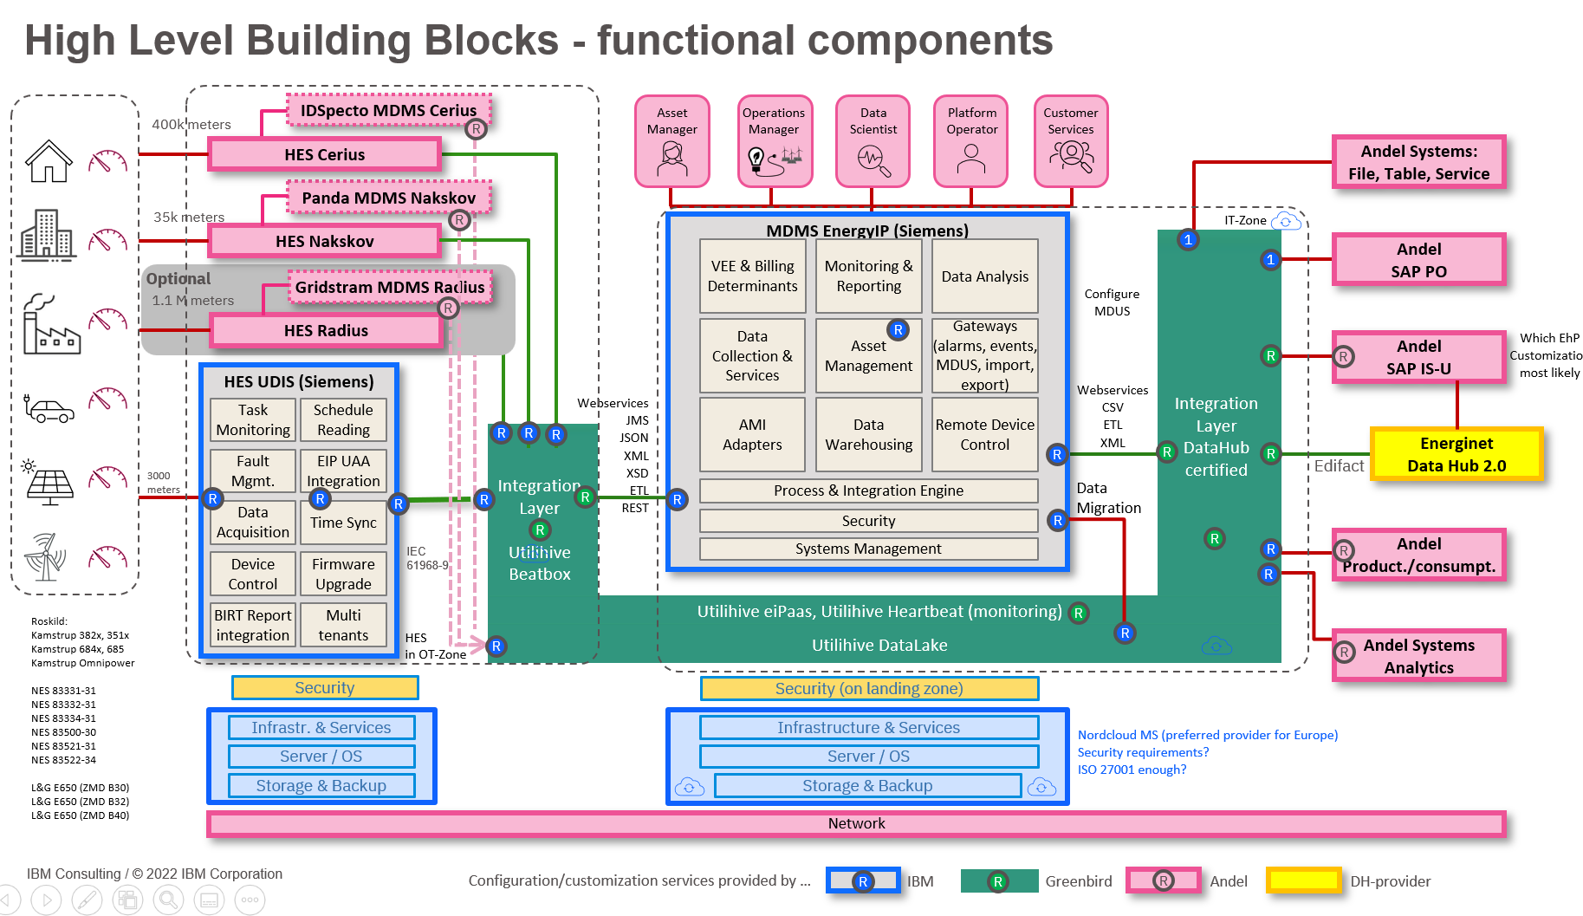
BTS BPO | BTS Non BPO | HCT | HCM | Cloud
Solution Design / Architecture Overview
Architecture Design owned by:
Client | IBM
Design / Architecture Principles
{outline the key principles in solution design/architecture}
( Context Diagram )
Logical Architecture Diagram
Physical Architecture Diagram
( Component Diagram )
( Component Interaction Diagram )
( Key Process Flows )
Notes:
Owner : SSC

Slide 81
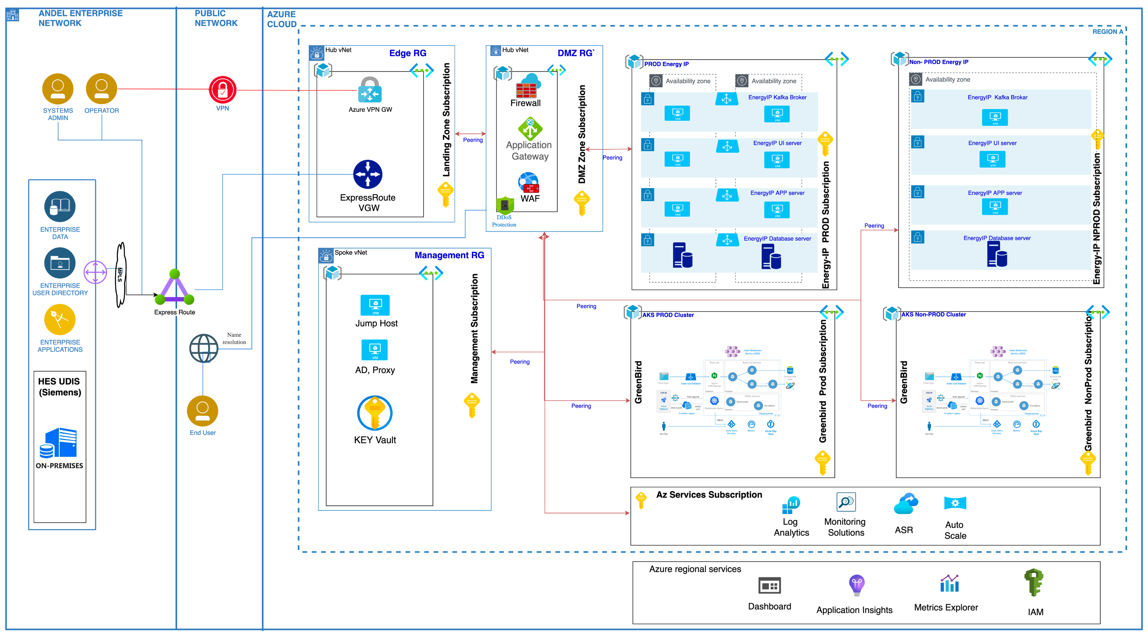
BTS BPO | BTS Non BPO | HCT | HCM | Cloud
Solution Summary: Network/Platform/Infrastructure/Resiliency Architecture (ALL)
Notes:
Owner : CSC

Slide 82
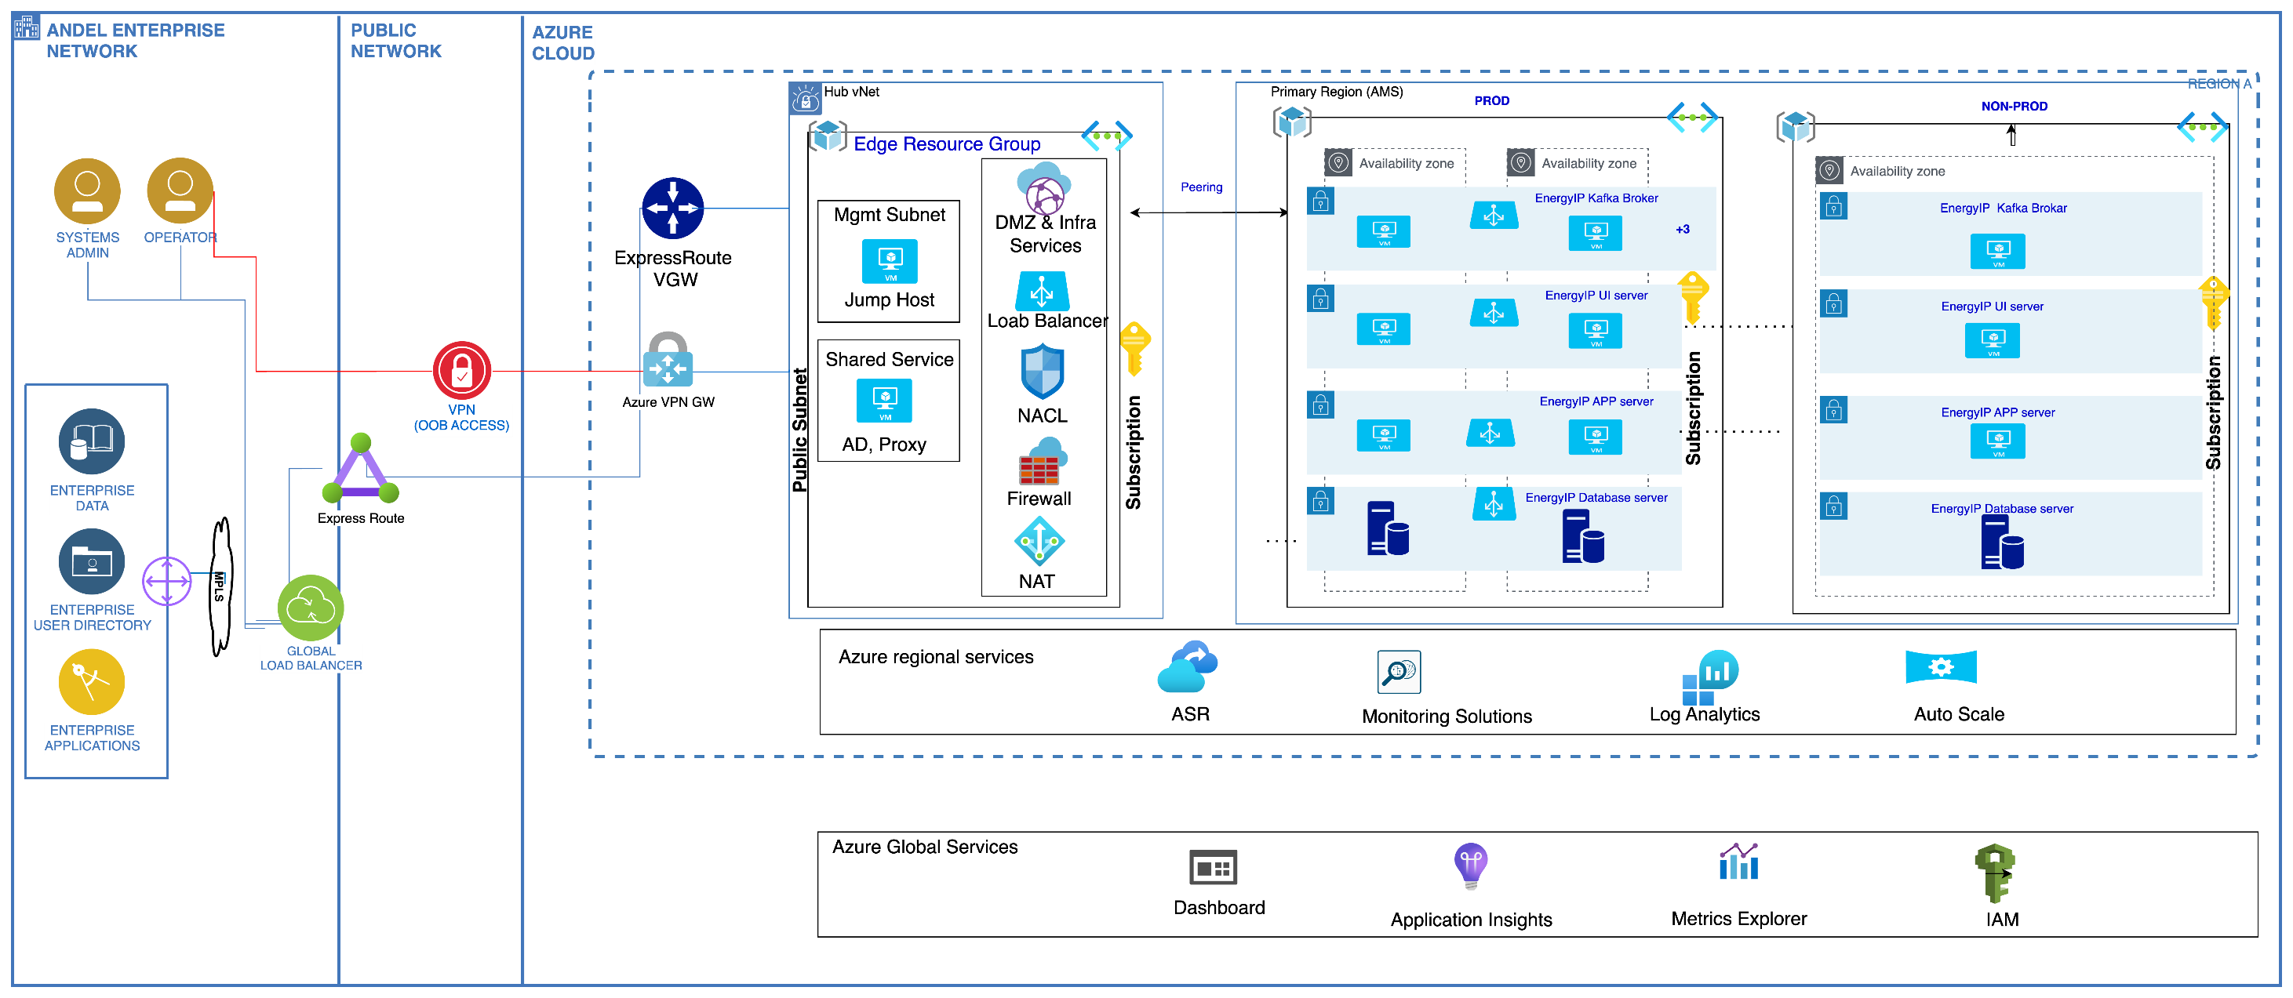
BTS BPO | BTS Non BPO | HCT | HCM | Cloud
Solution Summary: Network/Platform/Infrastructure/ Architecture EnergyIP(Siemens)
Notes:
Owner : CSC

Slide 83
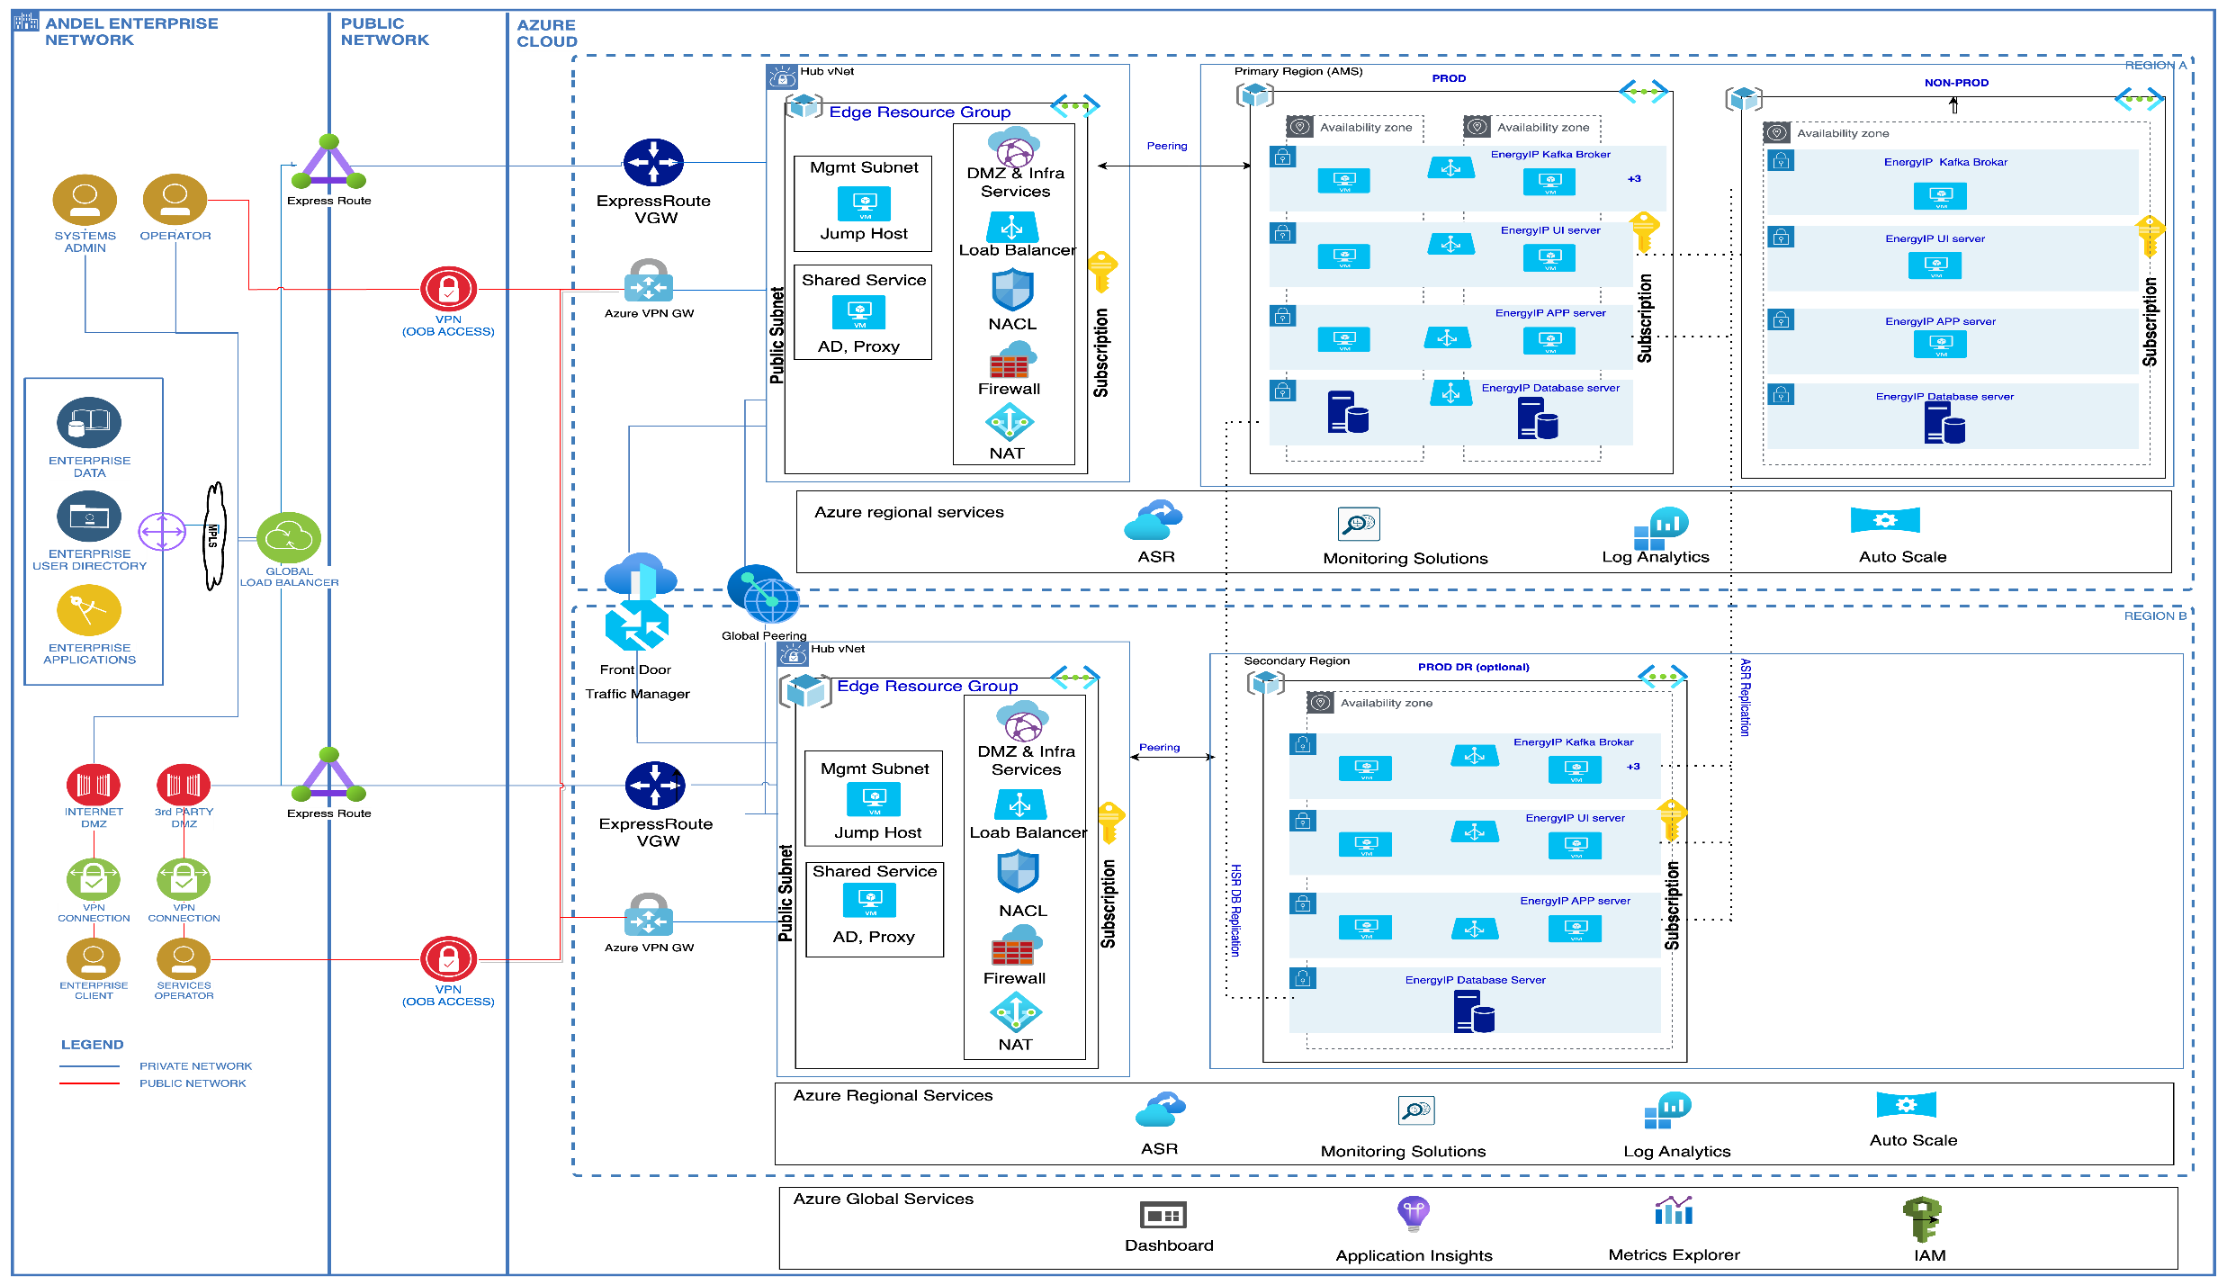
BTS BPO | BTS Non BPO | HCT | HCM | Cloud
Solution Summary: Network/Platform/Infrastructure/Resiliency Architecture (With optional DR)
Notes:
Owner : CSC

Slide 84
Architecture Decisions
AD | Topic | Possible Alternatives | Component Decision | Potential Motivation
AD#1 | vNet for APP and DB | Single vNet for APP & DB Separate vNet for APP & DB | Single vNet for APP & DB
AD#2 | Azure vNet for Landscape | Single vNet Multiple vNet | (C) Multiple vNet
AD#3 | Subnet for APP and DB | Single Subnet for APP & DB Separate Subnet for APP & DB | (B) Separate Subnet for APP & DB
AD#4 | Enterprise Connectivity | Express Route S2SVPN | Express Route
AD#5 | Public Network Connectivity | Direct Link 2.0 Azure VPN Gateway | (B) Azure VPN Gateway
AD#6 | Networking – Public Connectivity/routing Options | Front Door Route Table & UDR | Front Door
AD#7 | Networking – Application Load Balancing Options | Azure Load Balancer Application Gateway | Azure Load Balancer
AD#8 | Segmentation & Custom Route Options Cont | Subnets vNet | Subnets
AD#9 | Firewall Options | Azure Firewall Palo Alto Networks CheckPoint | (A) Azure Firewall
AD#10 | Segmentation Options | ASG Network Security Groups | (B) Network Security Groups
AD#11 | Deployment Options | Single region and Single zone Single region and Multiple zone Multiple region and Multiple zone | (B) Single region and Multiple zone

Slide 85



Solution Overview Overall, Scope Demarcations - IBM and Andel
Application Manage Service
HCM
Build Automation / Build pipelines
Build Automation / Build pipelines (optional)
NC
Andel
Data Migration Service
Migration
DTT
Andel
Middleware Service
Build +Config - IBM Manage - Andel
Build +Config - IBM Manage – AMS
DSO / AMS
Middleware Service
DSO / AMS
Database Service
Database Service
NC
Build +Config - IBM Manage - Andel
DSO / AMS
Platform Engineering & IT Operations
DevOps & IT Automation
NC
Andel
Security Services
Security Services
SBU
Andel
Cloud Network Service
Co-Lo DC Network Service
NC
Andel
Hyperscaler Service
Co-Lo
Public Cloud
Co-Lo
Compute, Networking, Storage
Compute, Networking, Storage
Andel
IBM

Slide 86
Solution Overview Overall, Scope Demarcations - IBM and Andel. (For Andel)
For Andel
Application Manage Service
IBM
DevOps & IT Automation (optional)
DevOps & IT Automation (optional)
IBM
Andel
Migration Service
Migration Service
IBM
Andel
Middleware Service
Middleware Service
IBM
Manage - Andel
Design+Build – IBM
Database Service
Database Service
IBM
Manage - Andel
Design+Build – IBM
Platform Engineering & IT Operations
DevOps & IT Automation
IBM
Andel
Security Services
Security Services
IBM
Andel
Cloud Network Service
Co-Lo DC Network Service
IBM
Andel
Hyperscaler Service
Co-Lo
Public Cloud
Co-Lo
Compute, Networking, Storage
Compute, Networking, Storage
Andel
IBM

Slide 87
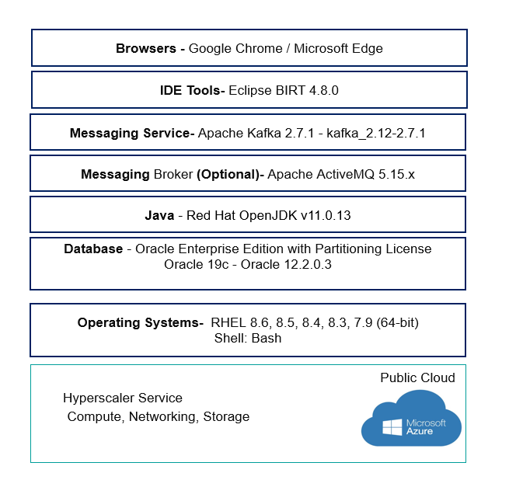
Solution Deployment Model

Slide 88
BTS BPO | BTS Non BPO | HCT | HCM | Cloud
VM Sizing
Notes:
Owner : CSC

Slide 89
BTS BPO | BTS Non BPO | HCT | HCM | Cloud
Azure Pricing
Refer to this pricing details:
https://ibm.box.com/s/u73uckrvru3g601v0u0aasysqogopphb
Notes:
Owner : CSC

Slide 90
BTS BPO | BTS Non BPO | HCT | HCM | Cloud
Azure Pricing (old)
Notes:
Owner : CSC

Slide 91

BTS BPO | BTS Non BPO | HCT | HCM | Cloud
Gobinda (WIP)
Andel – Integrated Operation - ITSM
Notes:
Owner : CSC

Slide 92
BTS BPO | BTS Non BPO | HCT | HCM | Cloud
Gobinda (WIP)
Architecture Decisions
AD # | Requirement | Alternatives | Component Decision | Reason
1 | Data
1.a | Integration
1.b | Governance
1.c | Analytics
1.d | Databases | Oracle DB2 | Oracle | As existing environment using oracle database .
1.e | Reporting and Visualization
2 | Compute
2.a | Bare Metal Servers
2.b | Virtual Servers
2.c | Virtualization
2.d | Containers
2.e | Serverless
3 | Storage
3.a | Primary
3.b | Archive
3.c | Backup
3.d | Data Migration
Notes:
Owner : CSC

Slide 93
BTS BPO | BTS Non BPO | HCT | HCM | Cloud
Gobinda (WIP)
Architecture Decisions (cont.)
AD # | Requirement | Alternatives | Component Decision | Reason
4 | Networking
4.a | Enterprise Connectivity
4.b | Segmentation
4.c | Cloud Connectivity
4.d | Network: DDoS & WAF
4e | Load Balancing
4.f | Content Delivery Network (CDN)
4.g | Domain Network Services (DNS)
5 | Security
5.a | Data Security
5.b | Identity and Access Management
5.c | Application Security
5.d | Infrastructure and Endpoint
5.e | Threat Detection and Response
5.f | Security Operations: Key Lifecycle Management
5.g | Security Monitoring & Intelligence: Logging / Log Management
5.h | Security Monitoring & Intelligence: Security Information & Event Management
5.i | Governance Risk and Compliance
Notes:
Owner : CSC

Slide 94
BTS BPO | BTS Non BPO | HCT | HCM | Cloud
Gobinda (WIP)
Architecture Decisions (cont.)
AD # | Requirement | Alternatives | Component Decision | Reason
6 | DevOps
6.a | Build and Test
6.b | Delivery Pipeline
6.c | Code Repository
7 | Resiliency
7.a | Backup
7.b | Disaster Recovery
7.c | High Availability
8 | Service Management
8.a | Monitoring
8.b | Logging
8.c | Auditing/Tracking
8.d | Alerting
8.e | Event Management
8.f | Management Orchestration
Notes:
Owner : CSC

Slide 95
BTS-CPS | BTS-Non CPS | HCT | HCM | Cloud
Gobinda (WIP)
PES Decision Matrix Compliance
Compliance Check
PES Delivery Organization
Service Scope:
Service Start Date:
Delivery Organization per PES Decision Matrix:
Delivery Organization in the Solution:
If different, rationale for alternate organization:
If Exception, Exception Approval
<<Cut and paste of Tom Coffas’ approval email>>
Instructions:
Attach a cut and paste of the PES Decision Matrix used to make the decision on the Delivery Organization marking the box for the appropriate team or partner identified.
Complete Compliance Check to reflect if within guidance or an exception.
If an exception, attach a PDF of the approval email from the HCM – Global Delivery Services Leader(Tom Coffas )
Delete the instructions
Template - 2022 Edition, Version 3.1
© 2021 IBM Corporation | IBM Confidential
Notes:
Responsibility of the PS&ITS CSL to complete this chart and include the additional details on the approval.

Slide 96
Service Transition Solution

Slide 97
Service Transition – Back bone of Delivery – 3 Tier Framework
Overview - Service Transition
Service Operational process
Service Level Management
Delivery Governance model
Establish SLA and Metrics Management Framework
Critical Measurement Areas
Key Performance Indicators
Measurement Approach and Targets
Establish a collaborative and effective
communication and governance model.
IBM recommends 3 tier model at these levels:
Strategic
Functional
Operational
By understanding Business Strategy, IBM will propose and establish required Operational and Strategic Processes by integrating Business and IBM Methodologies and Leveraging best practices like ITIL, but not limiting to the following processes:
Incident Management
Major Incident Management
Service Request Management
Change Management
Problem Management
Configuration Management
Release Management
IBM have a proven capability to implement ITIL processes assets based on business strategy, needs and on-demand.

Slide 98
service Transition methodology
Service Transition – Approach & Methodology
Transition Discover
Transition Sprint 0
Transition Sprint Execution
1-2 weeks
1-2 weeks
2-3 weeks/Sprint
Steady State
Transition Sprint 1..n (Execution)
Number of Sprints will depend on the number of Process & SLAs/Reports in scope. And the level of customization needed from As-Is ➔ “To-Be
Define &
Document
Sprints
Plan
Implement
Handover
Evaluation Criteria
Process as per Contract
Reports & Metrics as per contract
Process review and sign-off
Trainings Completed
Sprint Backlog Planning (SPT – Services Process Transition)
Overall Service Backlog Planning
As-Is ➔ To-Be
Process and Procedure
R1
R2
R3
Transition Health reviews
Deliverables / Work product
Overall Service Backlog Plan (D)
Transition service backlog list (WP)
Communication Plan (WP)
Deliverables / Work product
SPT Sprint Backlog Plan (WP)
Sprint Execution Plan (i.e. Scope and duration of each sprints) (WP)
Process assessment and sign-off criteria and (WP)
Deliverables / Work product
Process and Procedure Manual (D)
Service Level Management framework (D)
Client and IBM Team Training Completed (W)
Governance including daily standup meetings
Timeline

Slide 99
Service Transition – Entry & Exit Criteria by Phase
DISCOVER
SPRINT 0
SPRINT 1…n
ENTRY CRITERIA
Contract has been signed with client to proceed with the Overall Transition Planning activities
Transition team members (Key Client and IBM resources) have been assigned to the project
Overall Transition Plan agreed with client
Staffing in progress
High-level Process Gap Analysis Completed
Sprint Backlog Plan created
Required SMEs/Staff available
Process Gap Analysis available
EXIT CRITERIA
SPT - Sprint Backlog Plan (containing Process Stories, MAW Plans, and Story-wise Sprint Schedule)
Baseline Templates
SPT Kick-off completed
Required SME available
Process and Procedure Manual
Service level management framework established
Governance Manual for Steady State established
Sprint wise completion report
Deployment and training completed for IBM Team
Overall Service Backlog Plan (containing Communication Plan, Governance Plan, and overall sub-project Sprint plans and schedules)

Slide 100
Service Transition Implementation – AMS Scope
Table highlights with requested Service Transition scope, with high level Assumptions & Dependencies.
Processes & Governance | SLA / KPI Metrics | Reports & Dashboards
Below Mentioned Process are Scoped based on RFP (Can be revisited during the Planning Phase) AMS Processes Incident management Problem Management Service Request Management Change Management Release & Deployment Management Knowledge Management Availability Management Capacity & Performance Management Service level Management Continuous Service Improvement Governance Communication Plan Roles & Responsibilities Risk & Issue Management Org Chart Escalation Mechanism | Below mentioned Metrics are scoped Based on RFP Measurements End user Availability System Availability Incident Response Time per Priority Incident Resolution Time per Priority | Dashboards: (1 AMS Dashboard, with multiple Tabs) SLA Dashboard Incident Dashboard Problem Dashboard Service Request Dashboard Change Dashboard Enhancement Dashboard
ST Solution Effort (for above scope)
1 SME (Band 8/9) for 3 Months
Assumptions | Dependency (with Client)
Use IBM best practices Use the ITSM tool of Customer to support above Processes. Process, SLA, Reports will be part of ITSM tool used by Customer and same will be adopted/configured to suit AMS delivery readiness. For Reports/dashboards ITSM tool would be the single source of Truth | Client Ticketing Tool Process + Admin SME time & effort to support with required configurations for above Process, SLA, Reports, aligned to Process workshop discussions. Process Manuals and support feedback during Process workshops.

Slide 101
Service Transition – High Level Plan

Slide 102
IBMC Pricing Checklist
Focus: Amber: Outside typical range and should be noted /reviewed
Elements | Focus | Description
Pricer Name, SDM modeler name: |  | Raphael Bolle, Tamas Baltzer
TCV $M, Contract Duration: |  | Price = 19 945 707 spot EUR (excl pass through of 8M EUR) Net Price = 18 948 422 spot EUR ; Duration 96 m / 8 y ; start: 06 2023 end: 05 2031
Price Type, Contract Type, New? validity: |  | Price Type :B&P , Contract type: FP, Deal Type: a new project
Total NPV GP% / Nominal neg. GP |  | 28% NPV GP, no neg GP in any quarter
Credit check: |  | Credit check to be requested
Rate Card: |  | the deal involves uncommitted/ committed rate card
Rev Recognition: |  | N/A
RA: |  | 18.3% & 5% on OEM SW
Risk Level / Contingency: |  | Risk rating 7 ; Risk contingencies 2 849 k spot EUR = 25 % of base cost on average; assumed 5% penalty on SLAs
Key (Non) Standard Terms & Conditions: |  | N/A
Sub-Co, OEM HW/SW, SaaS : |  | OEM HW/SW cost 25 228
Governance / Management priced in: |  | EXEC: 0 man-days ; B10: 1 675 man-days on a total of 17 410 = 9.6 %
Billing Schedule: |  | Billing schedule: Monthly in arrears
Payment Terms: |  | Standard
Inflation risk coverage, COLA clause: |  | COLA clause assumed, inflation adders removed
FX risk coverage, FX clause: |  | FX clause assumed, FX adders removed
Travel & Living: |  | N/A
Assets / HR transfers, Capital: |  | N/A
Observations:
101
© 2022 IBM Corporation | IBM Confidential
Notes:
Slide Summary
The Pricing Check list provides a summary of the pricing characteristics of the deal. It is primarily used to highlight any unusual or non-standard pricing concerns.
Please use Amber in the Focus column to highlight to any items that are outside normal range expected..
Typical Questions in PRR
Be prepared to give a case for approval of any exceptional terms. Typical examples:
Why should IBM agree to non-standard payment terms for this proposal?
Have F&P reviewed any revenue recognition concerns, what mitigations are in place ?
For UKI deals, confirm that UKI COLA/FX guidance has been applied to the deal (https://ibm.ent.box.com/s/wc0ytl4j1tmpqcluahen23v6dto2pwl7)
Are governance/management overheads sufficient priced in, in particular P/AP time?
Additional Guidance
FX, FX Clauses: https://w3.ibm.com/w3publisher/emea-services-pricing-community/pricing-topics/fx (EMEA Services Pricing Community Handbook, for access contact Denisa Lelenkova, Monika Brachnakova or Alexander Andreev)
COLA, COLA Clauses: https://w3.ibm.com/w3publisher/emea-services-pricing-community/pricing-topics/inflation (EMEA Services Pricing Community Handbook, for access contact Denisa Lelenkova, Monika Brachnakova or Alexander Andreev)
Powers Reserved for non-Standard terms: https://w3.ibm.com/w3publisher/gbs-europe-crm-supporting-information/pricing-delegation (CRM Playbook - delegation letter)
Contact your Sector CFO for Signings/Revenue Recognition questions
UKI Specific COLA/FX Guidance: https://ibm.ent.box.com/s/wc0ytl4j1tmpqcluahen23v6dto2pwl7

Slide 103
I&E per Contract Years
102
© 2022 IBM Corporation | IBM Confidential
Notes:
Slide Summary
This slide, and the following ‘I&E per Calendar Year’ slide, give an overall financial summary of the deal. Approvers will take an interest in the profile of revenue/cost/GP over the years of the contract, in particular:
- Discrepancies between ‘Price as Billed’ and revenue
- Uneven GP% profile across years of contract
- Any contract years with <18% GP (at point of writing, check on latest ‘tolerances’ for GP with Risk Management).
Typical Questions in PRR
Why is there a difference between Price and Revenue in Year X of the contract? Typical reasons could be: PoC based accounting, “AP Rev SO Cloud” (former AP07) treatment, netting
What is the overall GP%, is this acceptable to the business Confirmation that P&L stakeholders are lined up to the GP%, if low
Why is there an uneven distribution of GP% over the years of the contract. If GP% is not evenly distributed, the accounting treatment may be called into question (should all revenue be recognized in early years, should PoC or “AP Rev SO Cloud” (former AP07) be used, etc.)
As a rule of thumb, approvers will look for GP of 18%+ in all years.
Additional Guidance
PoC Accounting: https://w3.ibm.com/w3publisher/uki-risk-de-wiki/process/process-o-r/poc-accounting (UKI Risk Wiki)
GP approval levels: https://w3.ibm.com/w3publisher/gbs-europe-crm-supporting-information/pricing-delegation (CRM Playbook - delegation letter)

Slide 104
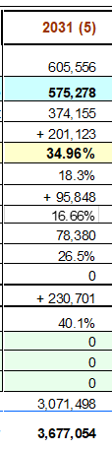
I&E per Calendar Year
103
© 2022 IBM Corporation | IBM Confidential
Notes:
Slide Summary
This slide gives an overall financial summary of the deal. Approvers will take an interest in the profile of revenue/cost/GP over the calendar years of the contract, in particular:
- Discrepancies between ‘Price as Billed’ and revenue
- Uneven NPV GP% profile across years of contract
- Any contract years with <18% NPV GP GP (at point of writing, check on latest ‘tolerances’ for NPV GP% with Risk Management)
Typical Questions in PRR
Why is there a difference between Price and Revenue in Year X of the contract? Typical reasons could be: PoC based accounting, “AP Rev SO Cloud” (former AP07) treatment, netting
What is the overall NPV GP%, is this acceptable to the business Confirmation that P&L stakeholders are lined up to the NPV GP%, if low
Why is there an uneven distribution of NPV GP% over the years of the contract. If NPV GP% is not evenly distributed, the accounting treatment may be called into question (should all revenue be recognized in early years, should PoC or “AP Rev SO Cloud” (former AP07) be used, etc)
As a rule of thumb, approvers will look for NPV GP of 18%+ in all years.
Additional Guidance
PoC Accounting: https://w3.ibm.com/w3publisher/uki-risk-de-wiki/process/process-o-r/poc-accounting (UKI Risk Wiki)
NPV GP approval levels: https://w3.ibm.com/w3publisher/gbs-europe-crm-supporting-information/pricing-delegation (CRM Playbook - delegation letter)

Slide 105
Summary by service line
104
© 2022 IBM Corporation | IBM Confidential
Notes:
Slide Summary
This reports shows the split of finances across the Service Lines involved in the proposal. The guiding principles here are:
- Costs and revenue should be allocated to those Service Lines that hold the relevant offerings (and usually, but not always, perform the work)
- GP% should be equivalent across Service Lines
- Service Line leadership should be aligned to splits prior to PRR
Typical Questions in PRR
Why do we see an uneven distribution of GP % over the Service Lines involved in the contract? Note that there can be reasonable explanations for a mismatch, for example, GP being driven by ratecards and different resource mixes.
Confirmation that Service Line leadership is aligned to the split of revenue and GP.
Additional Guidance
<Pointer to GP/SL org chart>

Slide 106


